Slide 1

Web Application Programming
Monitoring Air Quality & Weather:
A Real-Time Dashboard
PNU Department of Mathematics, Yuri-Ahn, 19 November 2024

Slide 2
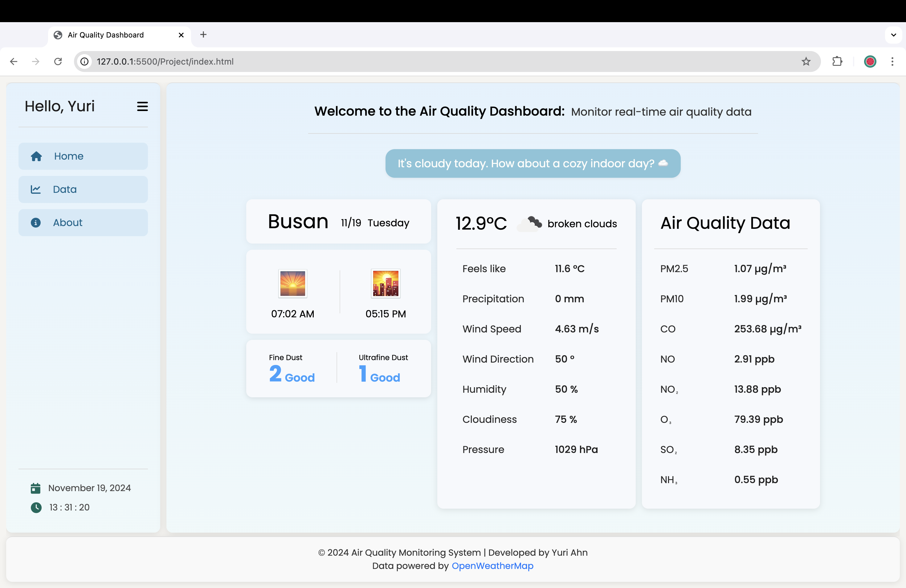
Real-Time Monitoring & Visualization of Air Quality and Weather Data

Slide 3
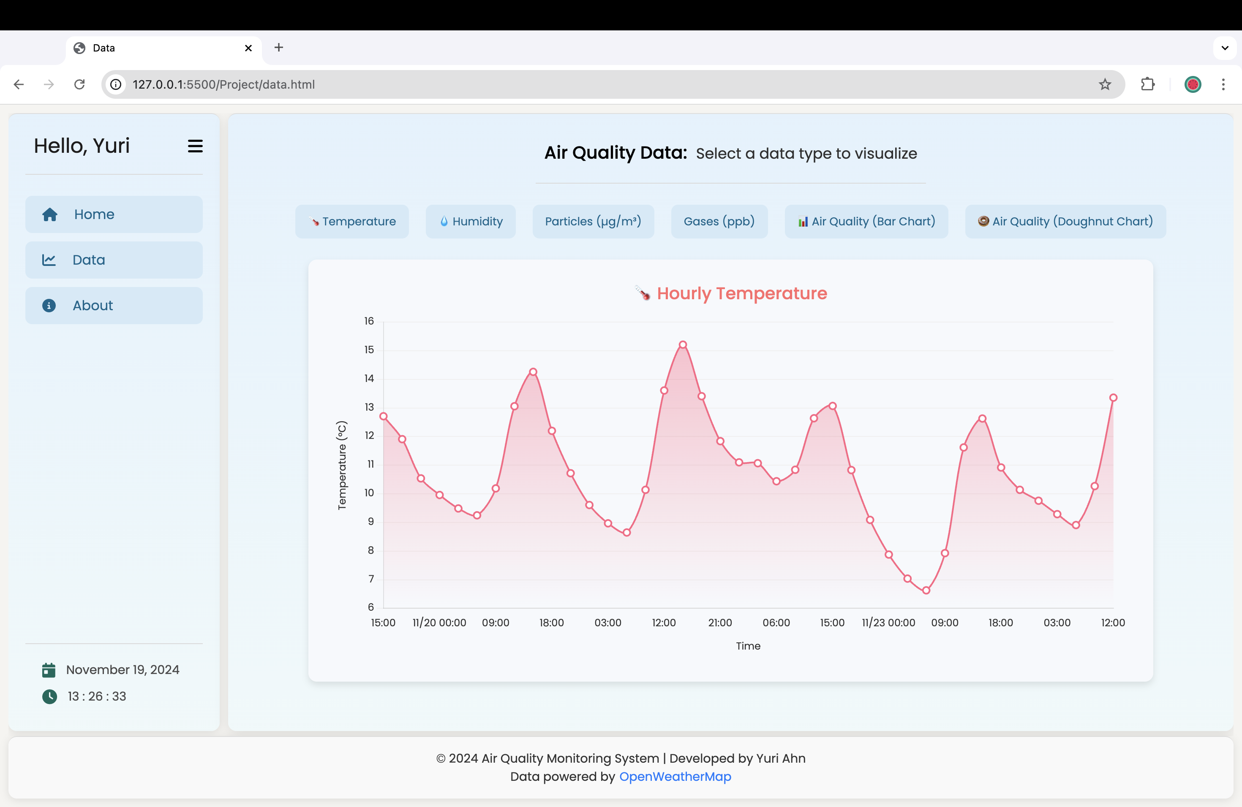
Real-Time Monitoring & Visualization of Air Quality and Weather Data

Slide 4
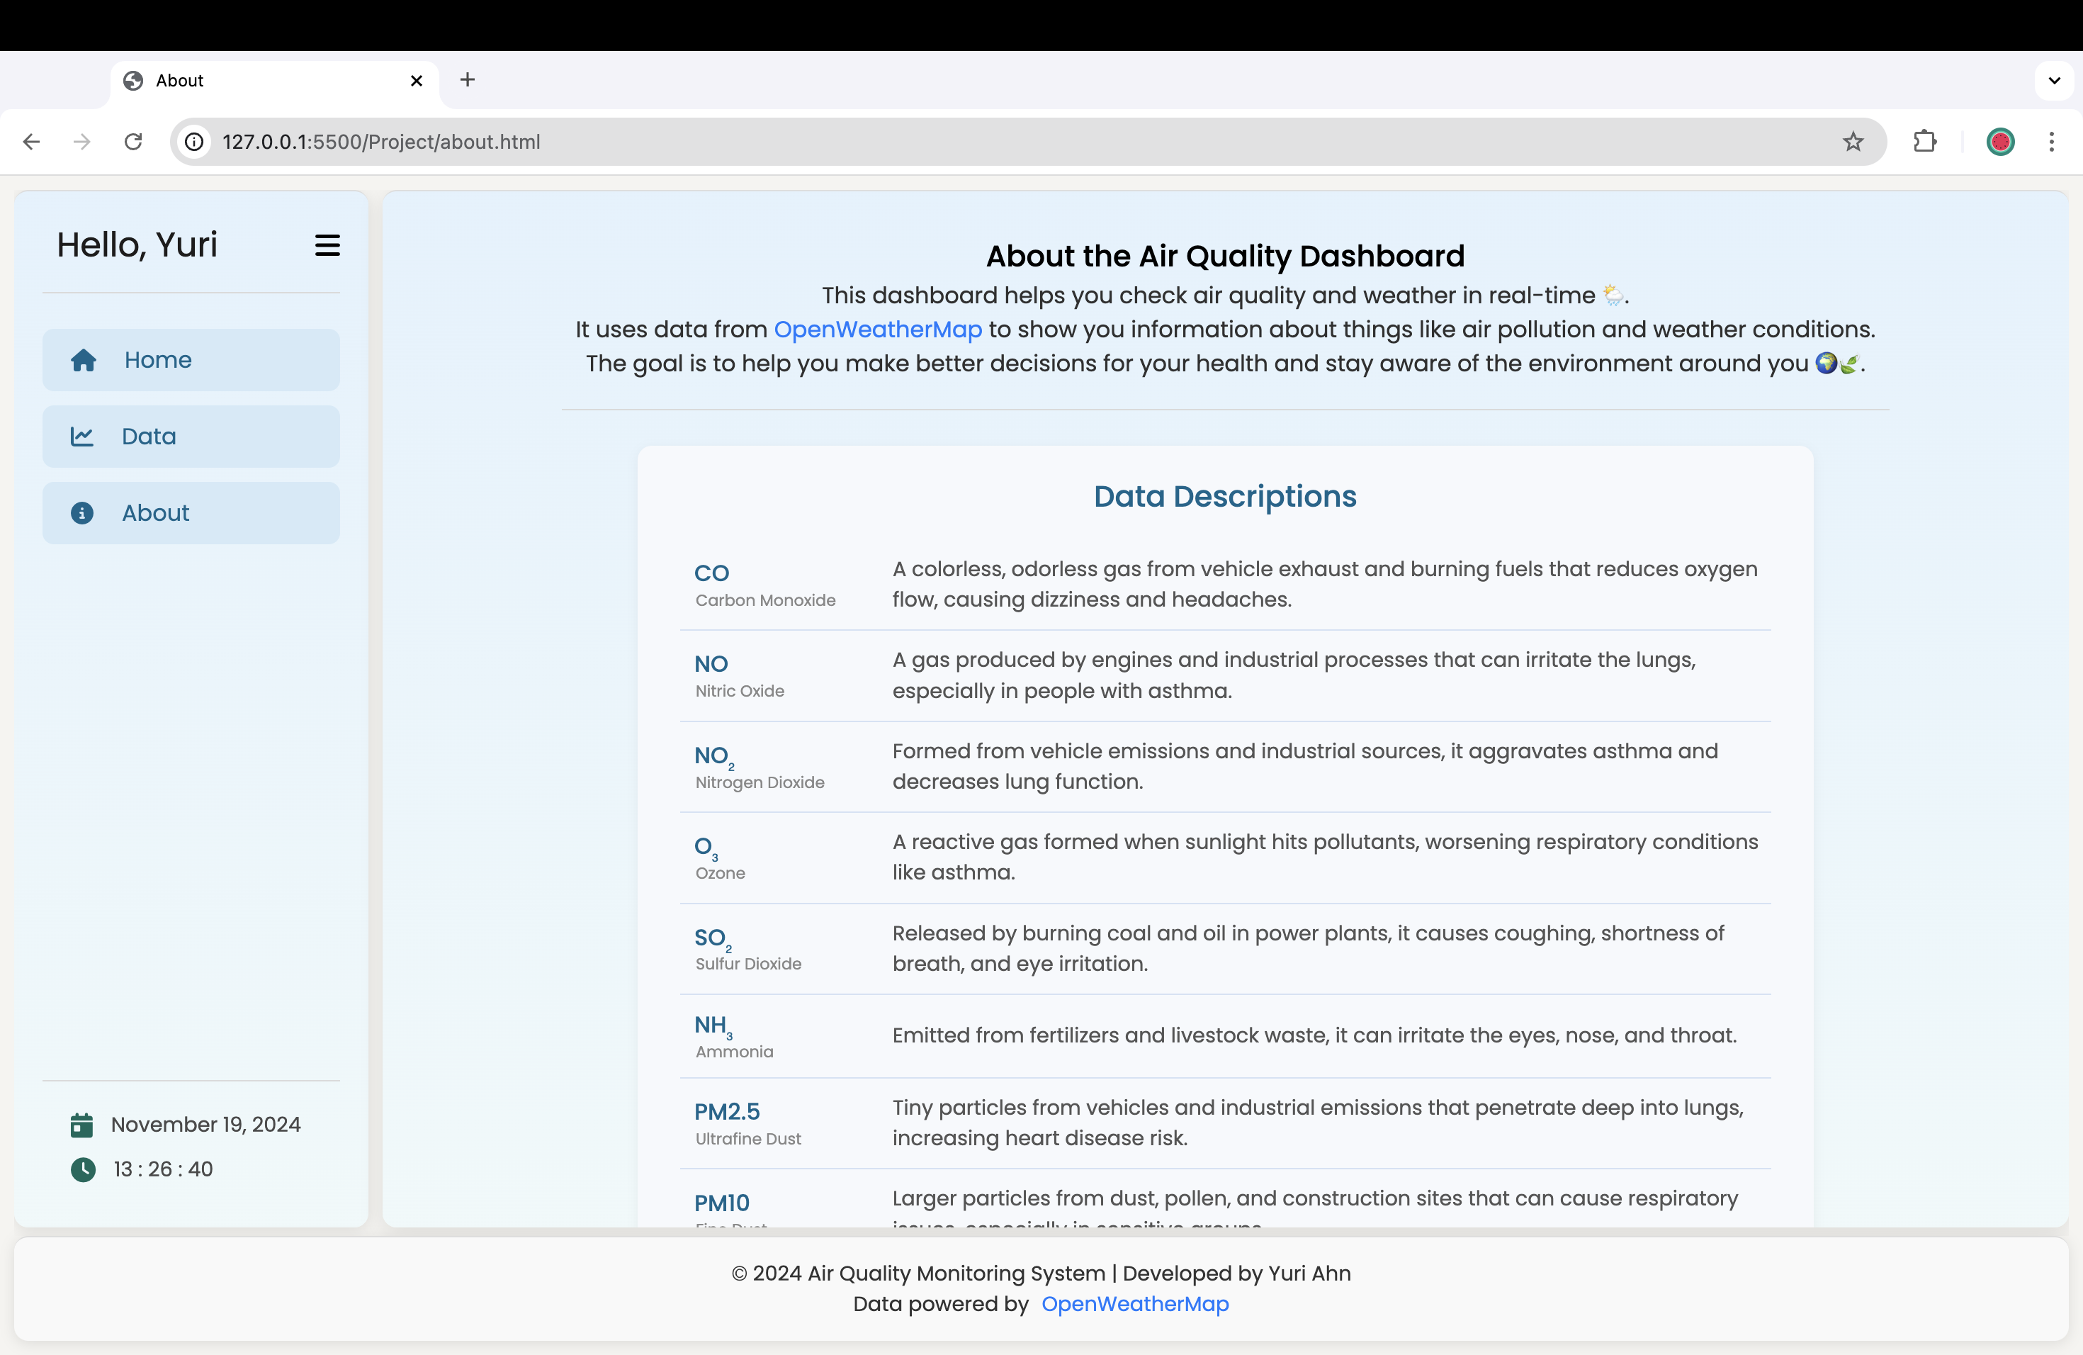
Real-Time Monitoring & Visualization of Air Quality and Weather Data

Slide 5
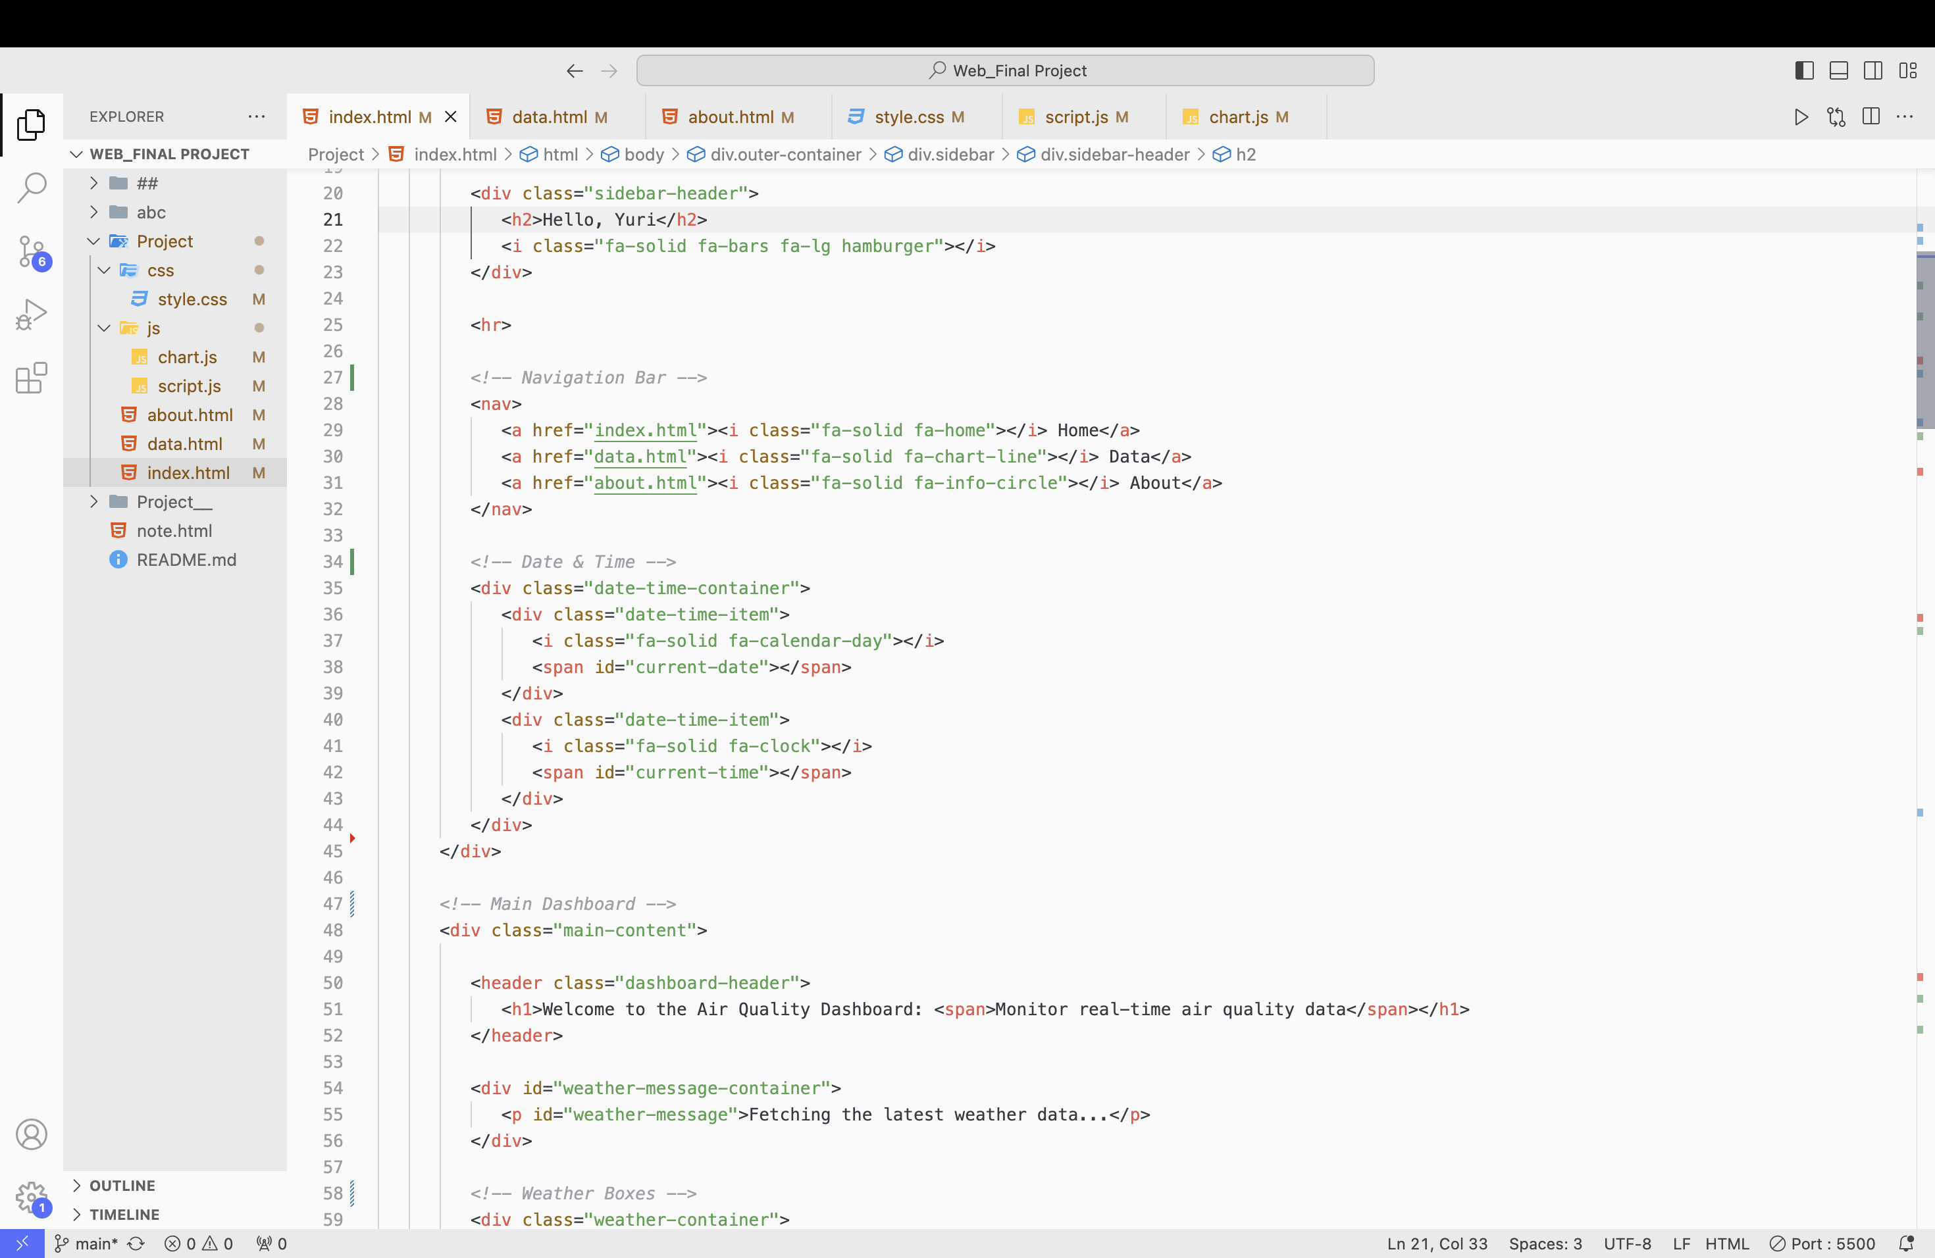
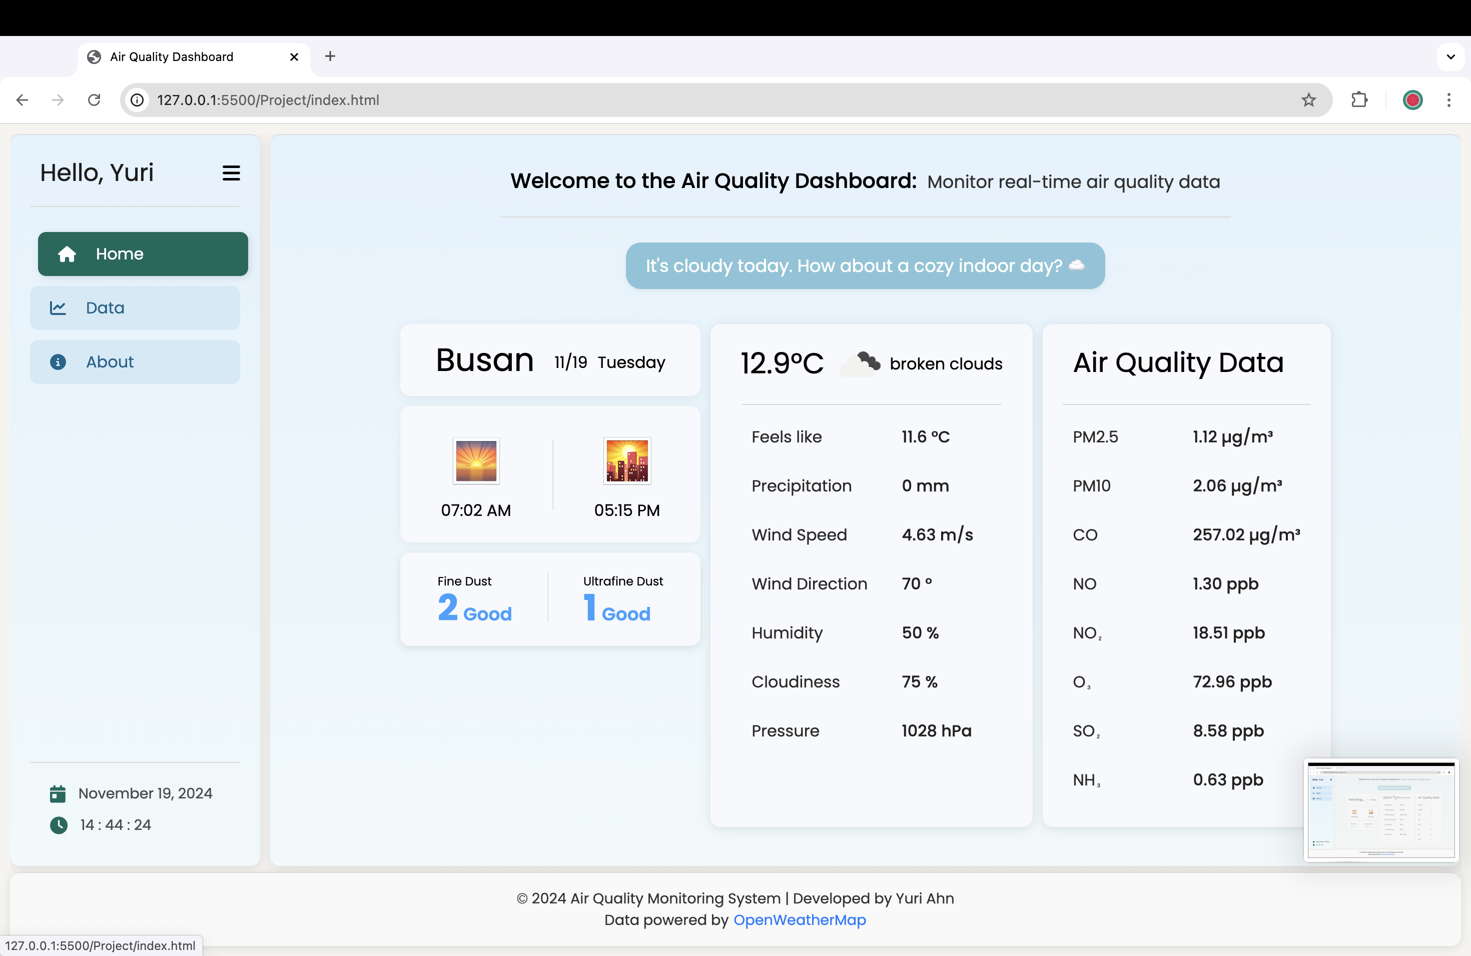
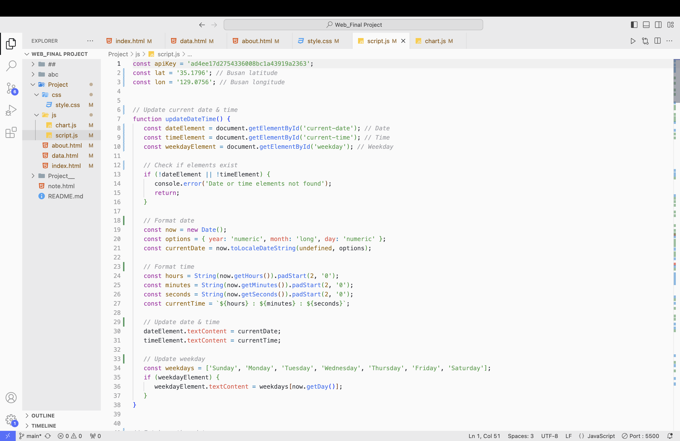
Sidebar: Including Navigation Bar
Mouse Hover

Slide 6
Main Dashboard

Slide 7
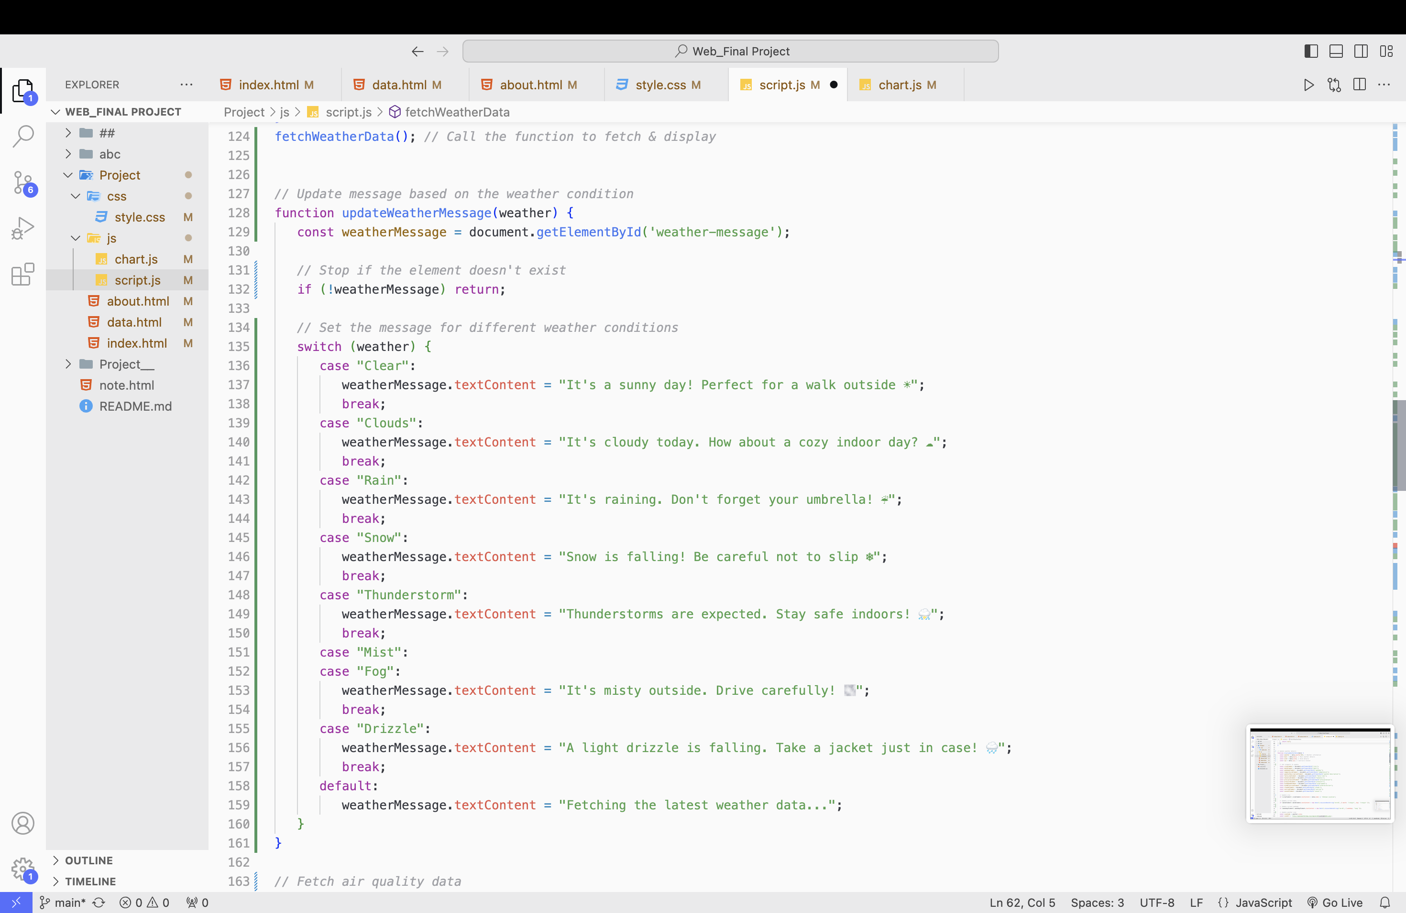
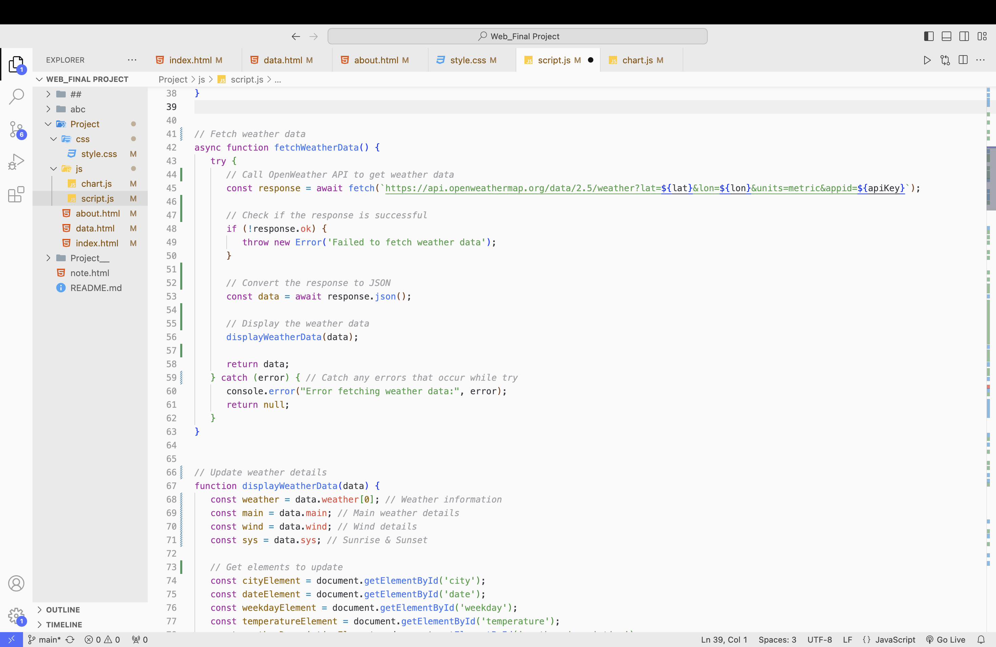
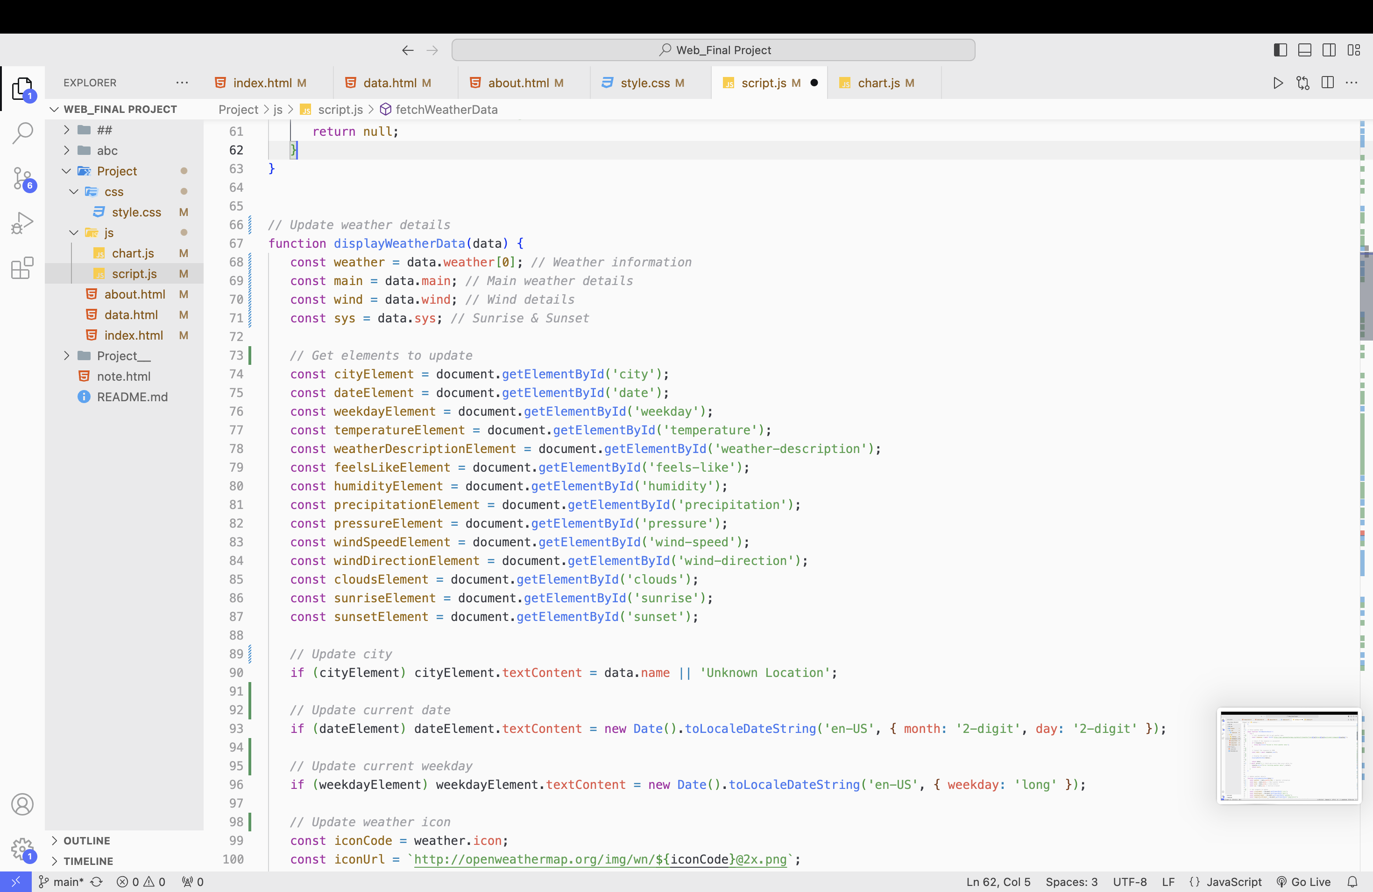
Main Dashboard: Weather-Message
3️⃣
1️⃣
2️⃣

Slide 8
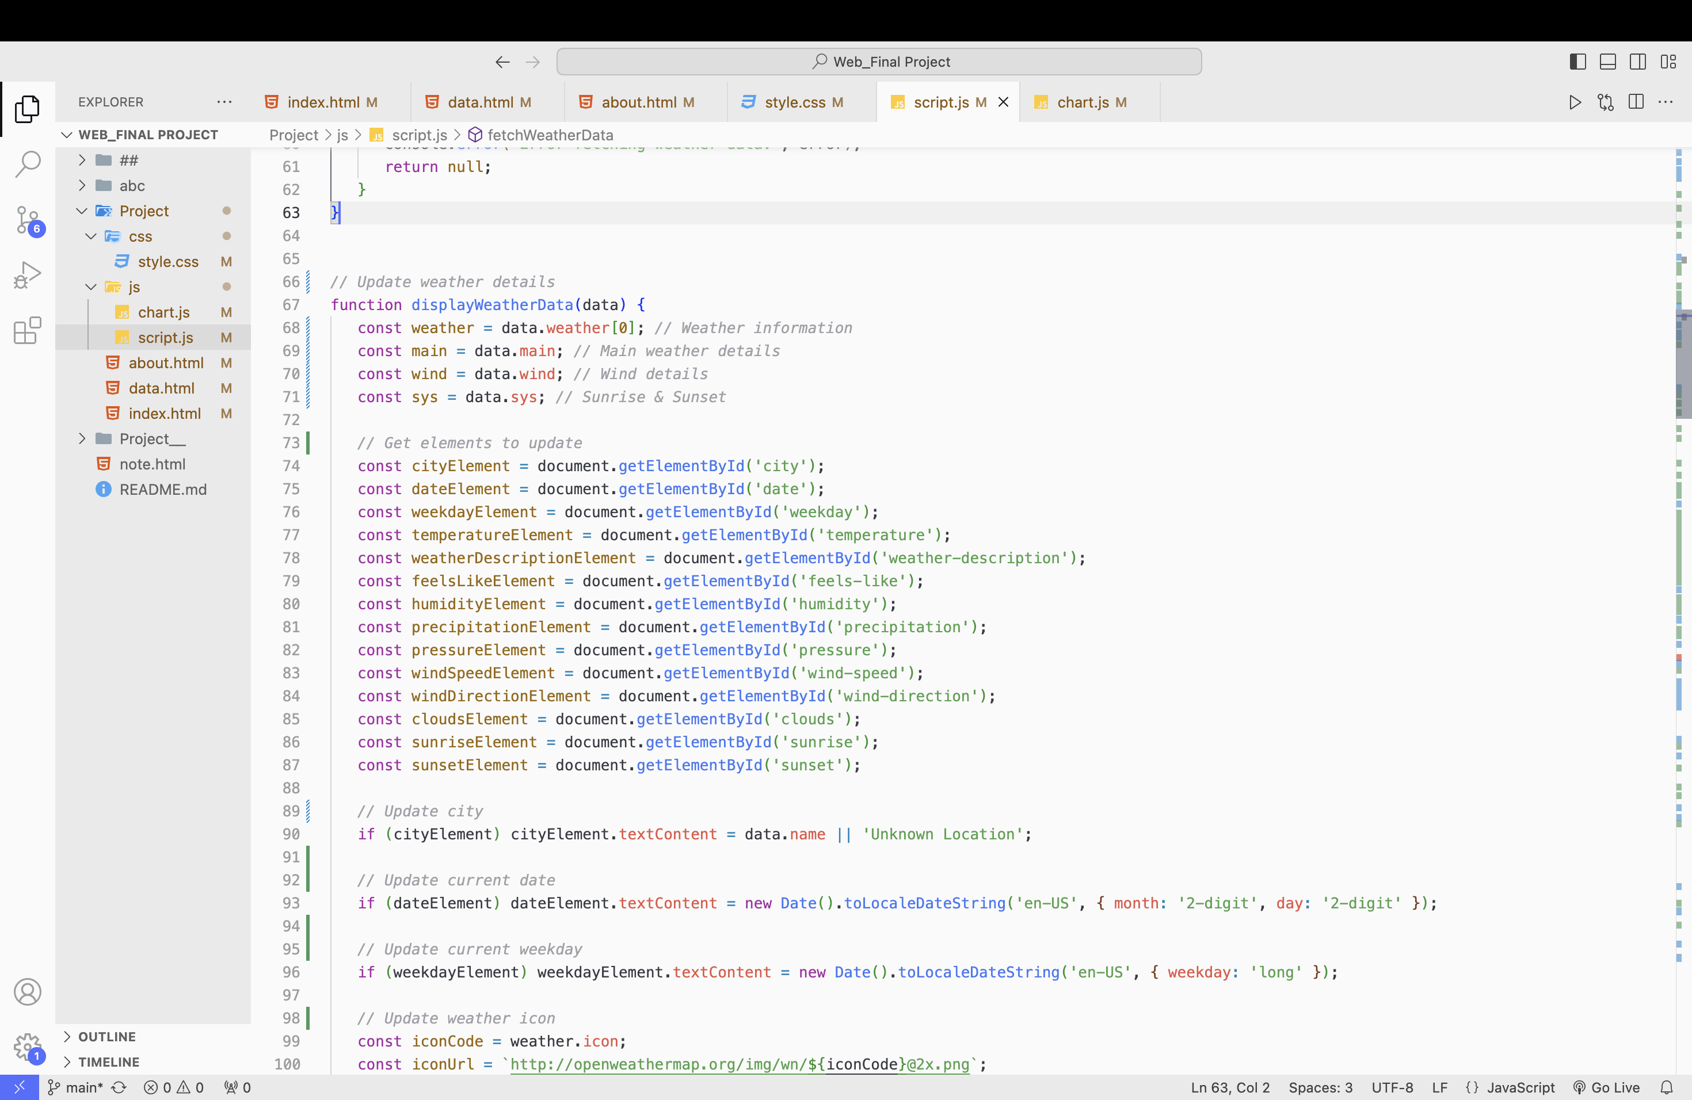
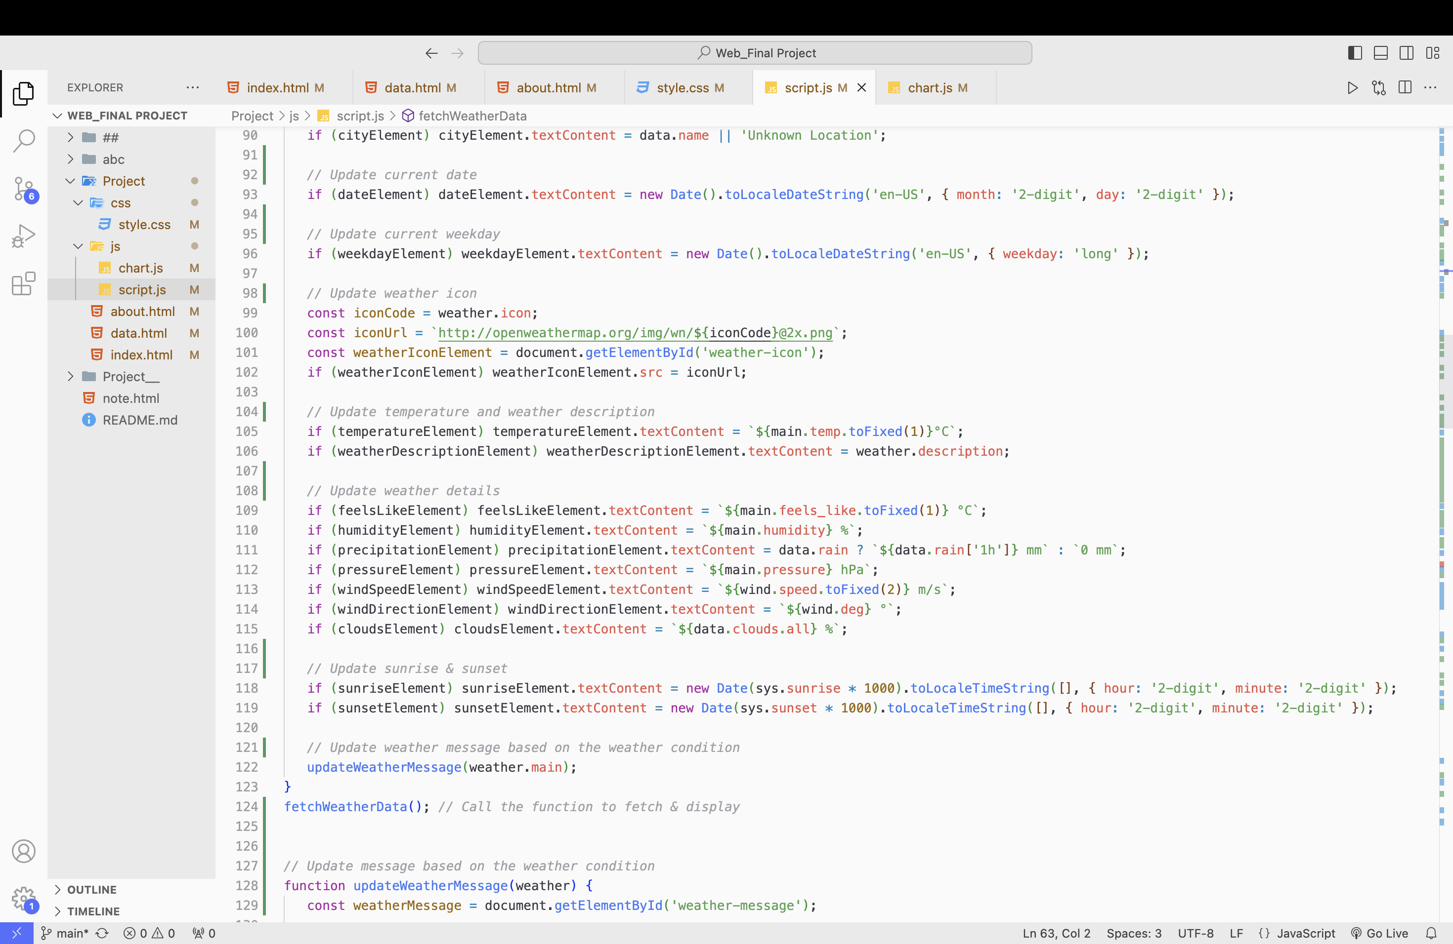
Main Dashboard: Location & Date / Sunrise & Sunset
2️⃣
1️⃣
3️⃣

Slide 9
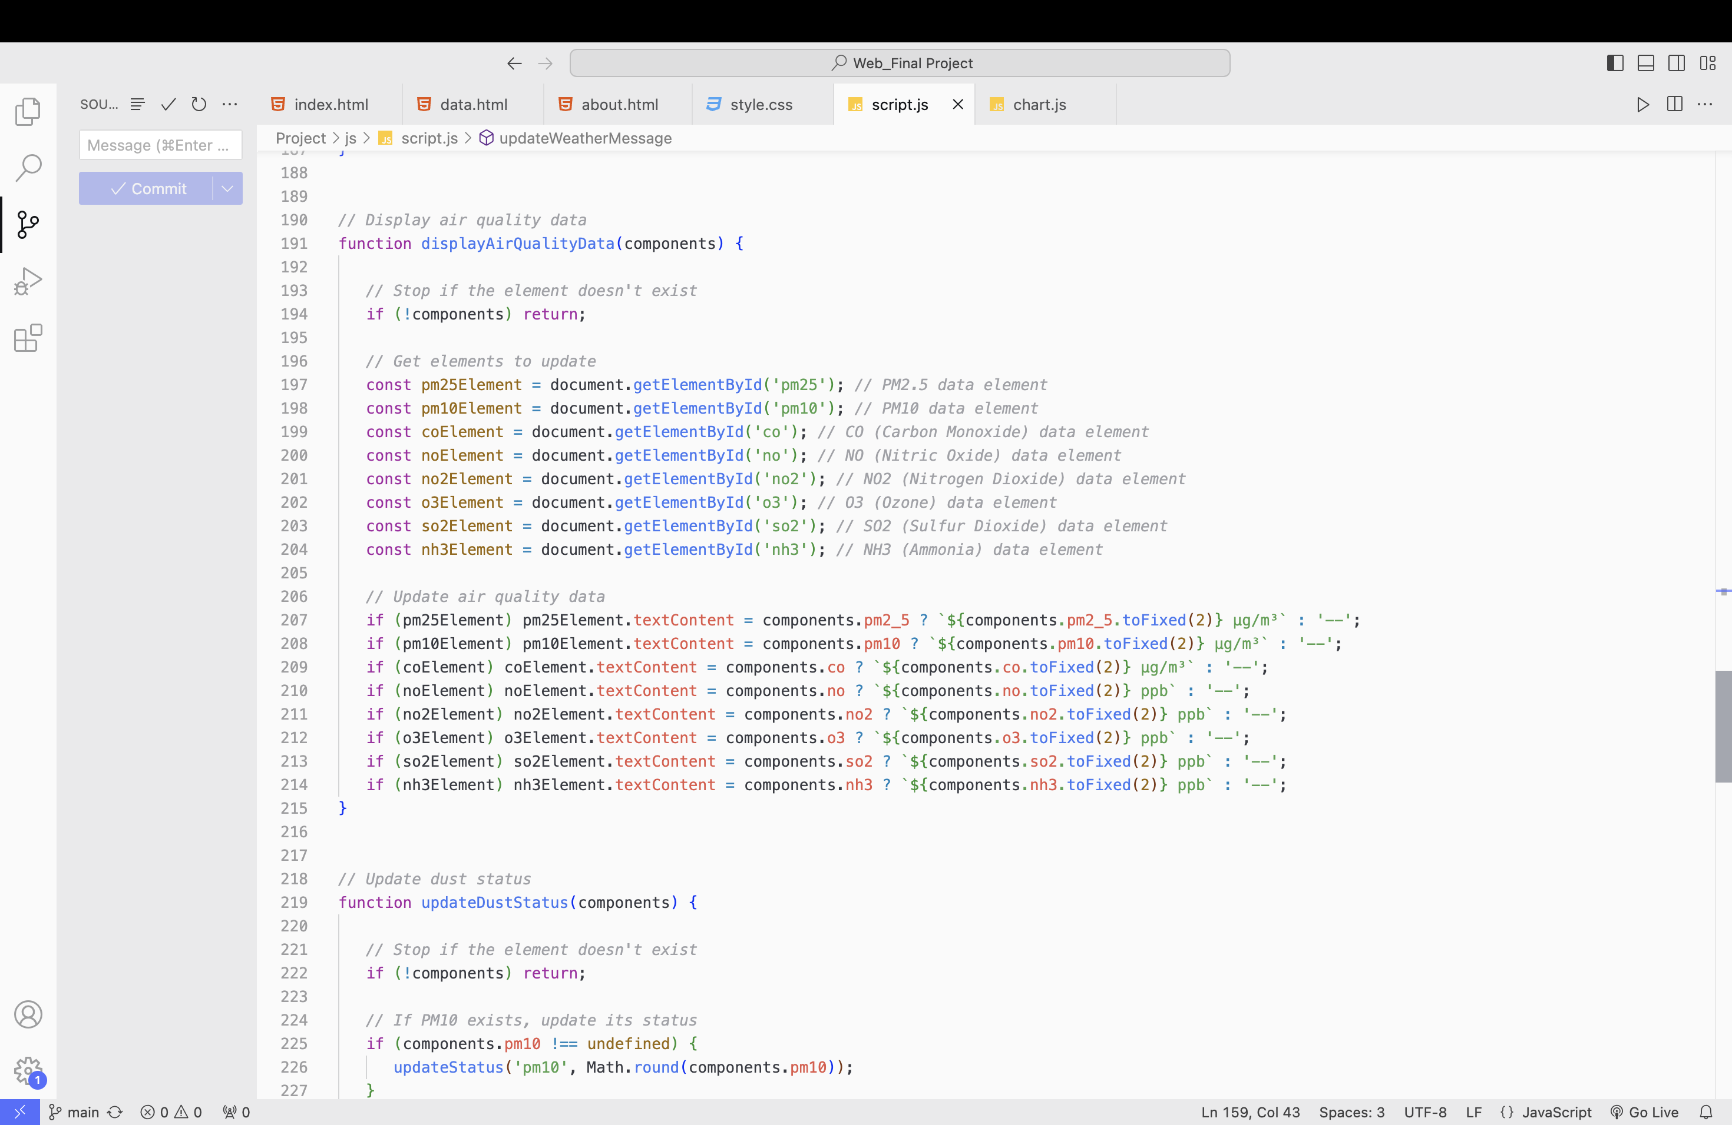
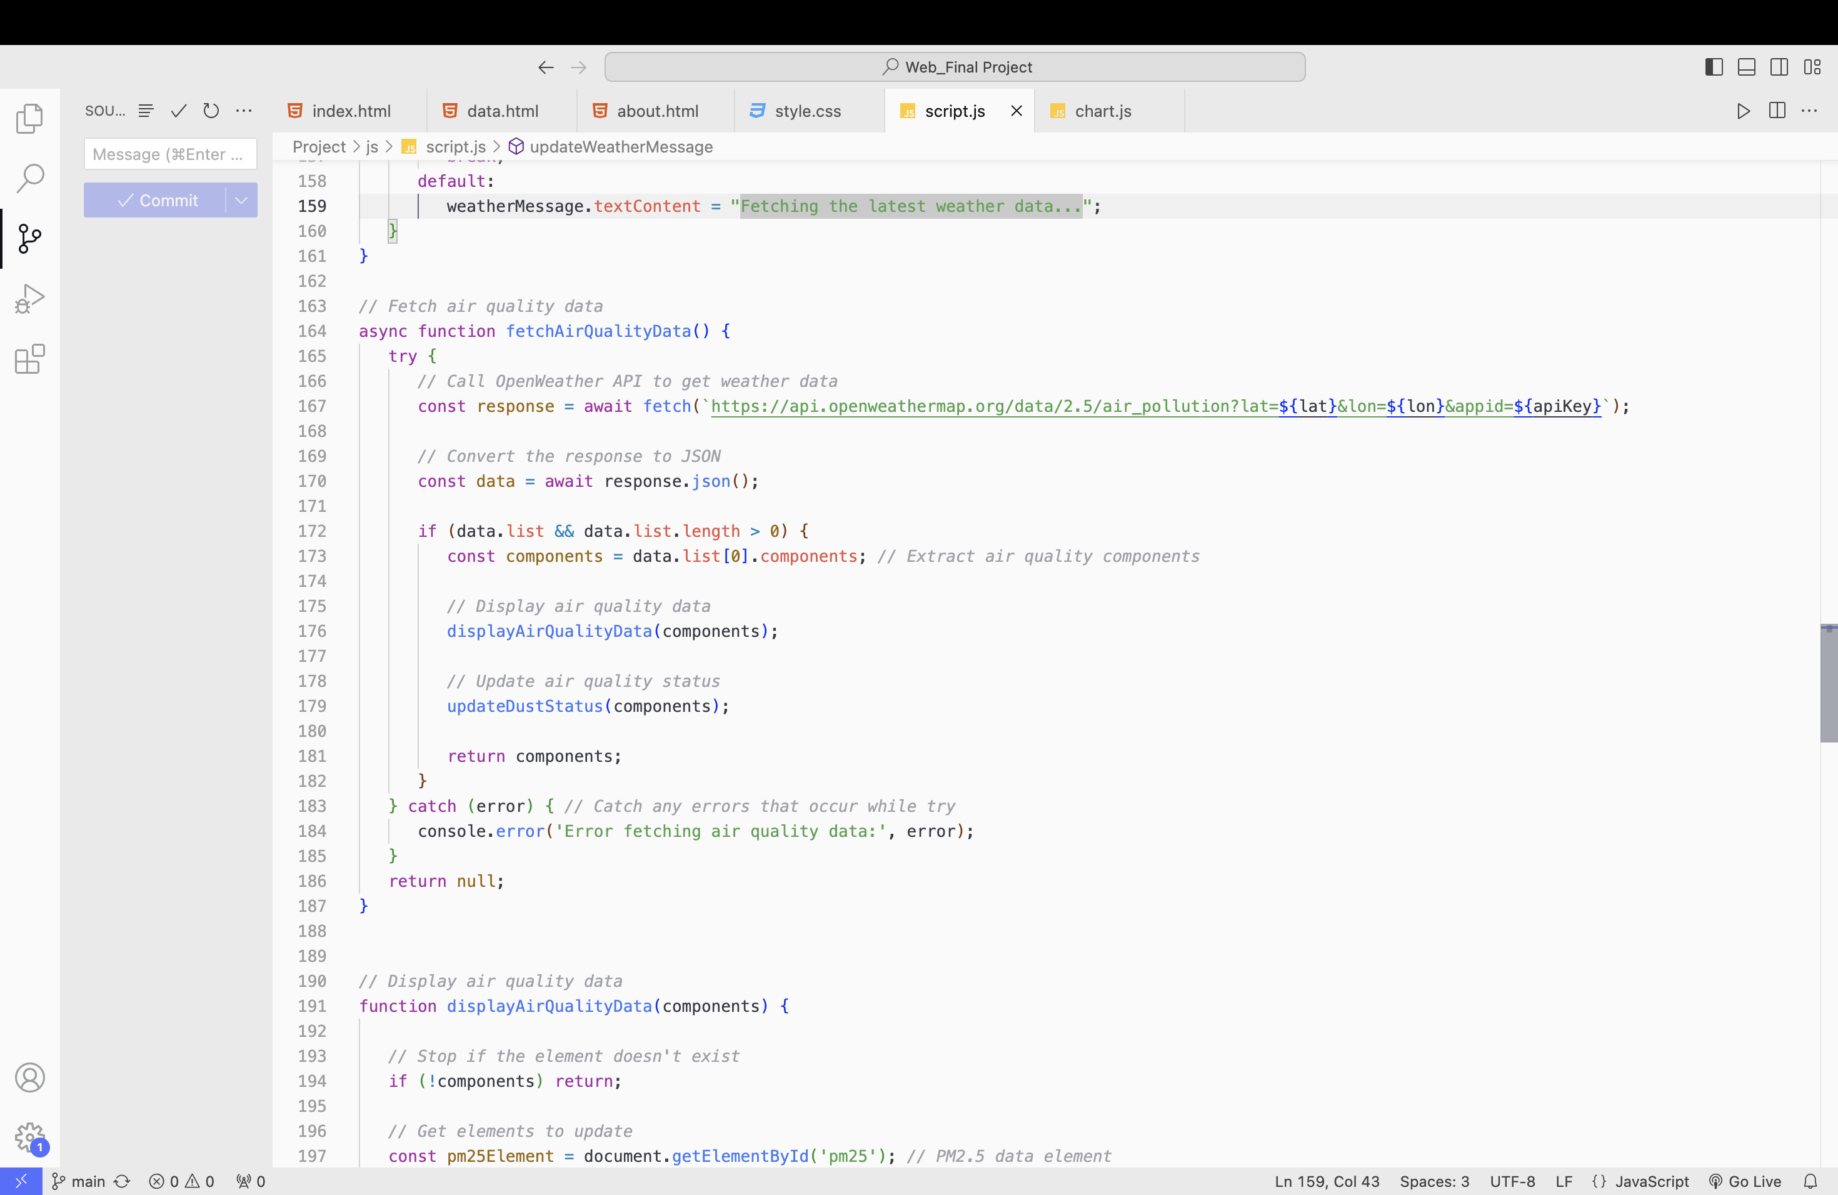
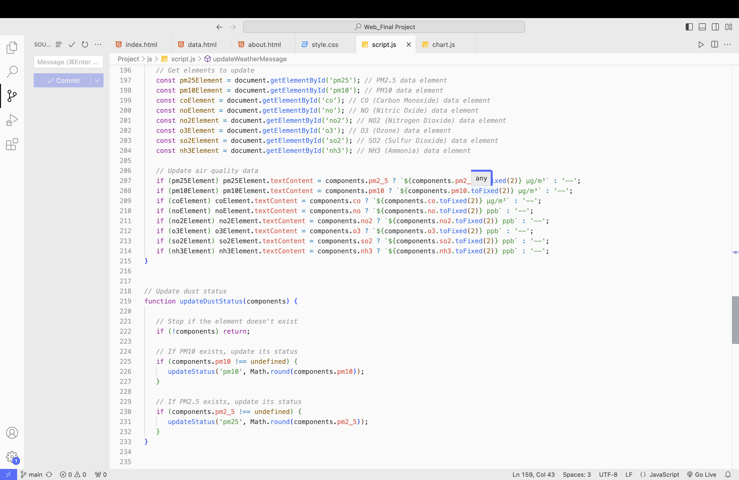
Main Dashboard: Air Quality Summary
2️⃣
1️⃣
3️⃣

Slide 10
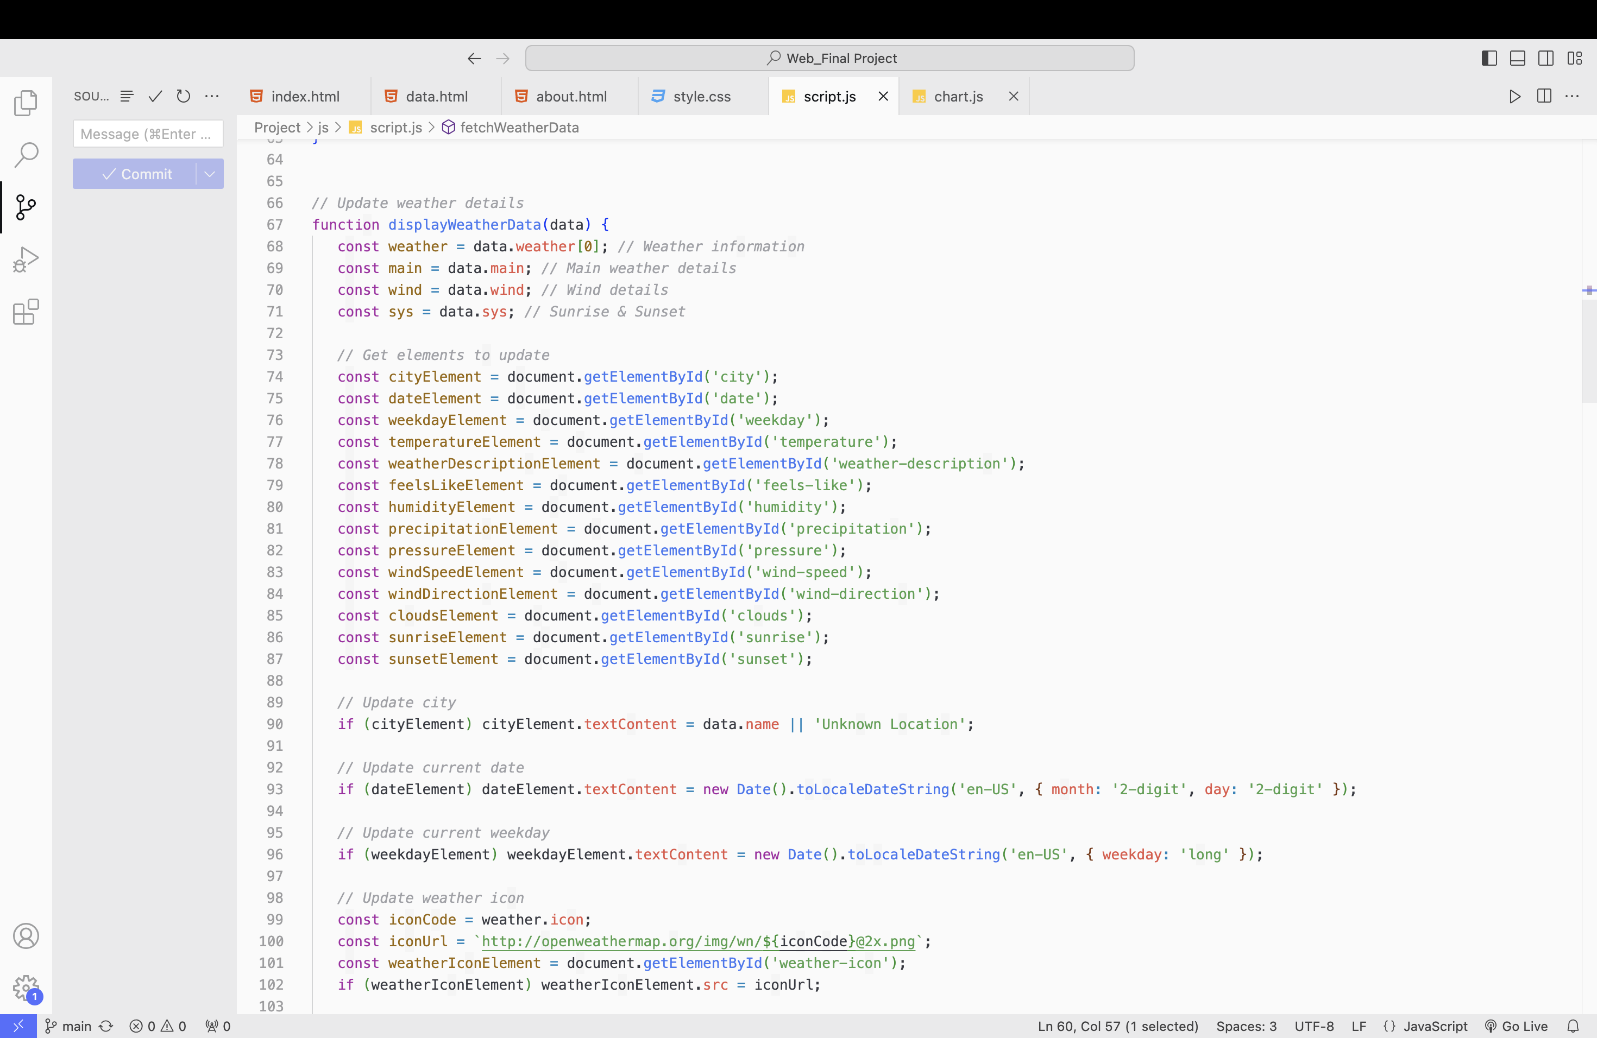
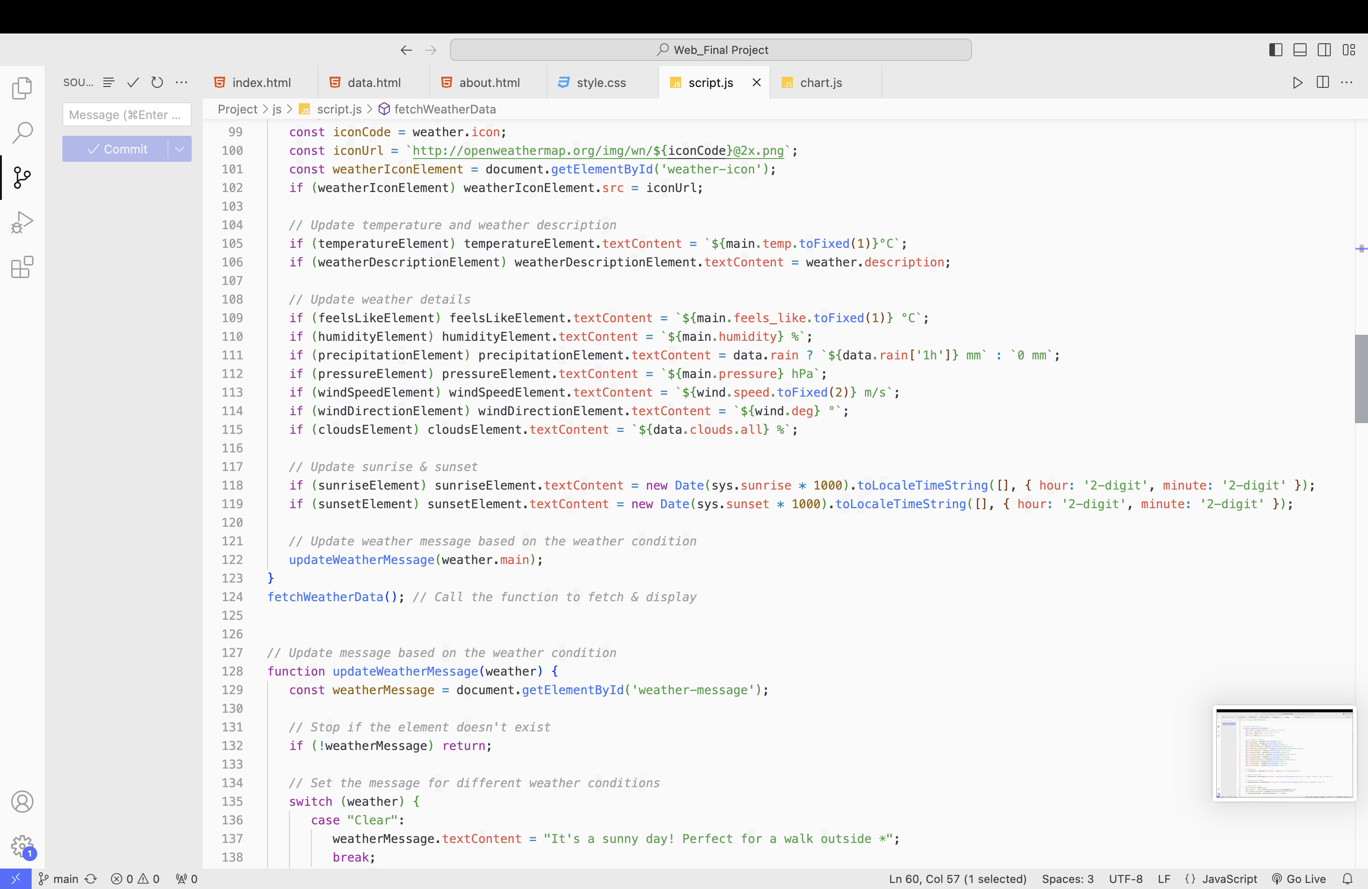
Main Dashboard: Weather Data

Slide 11
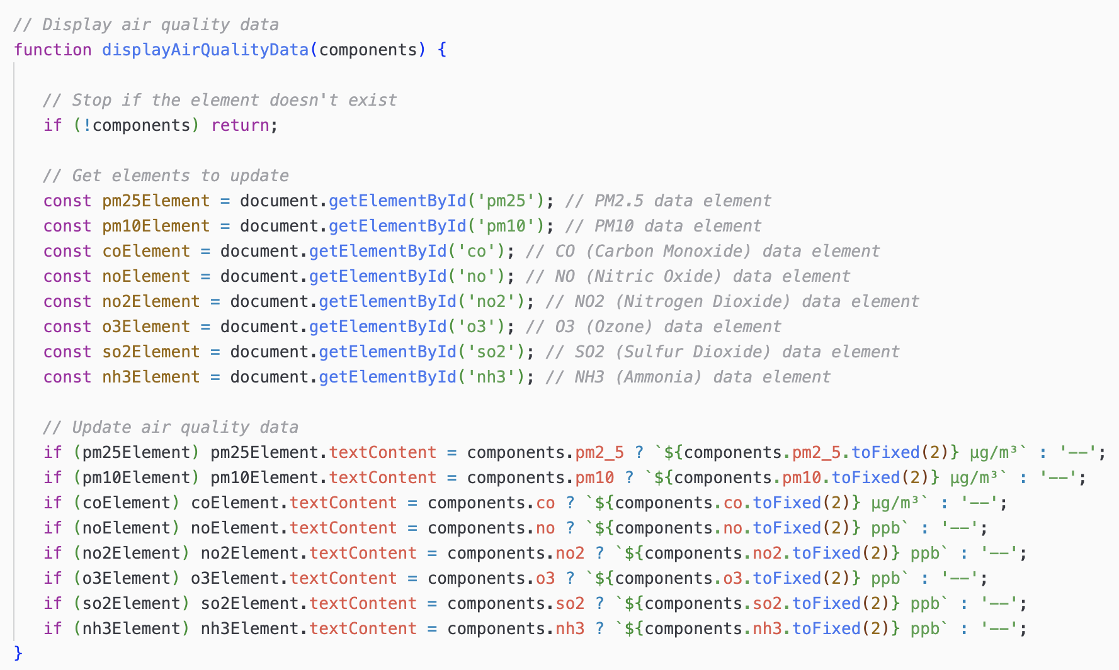
Main Dashboard: Air Quality Data

Slide 12
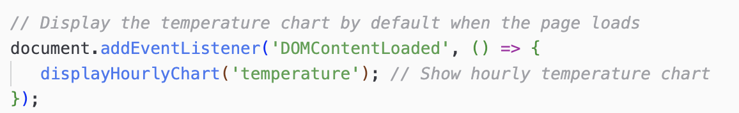
Visualizing Data
When button is clicked,
the corresponding chart is displayed
By default, the temperature
chart is displayed

Slide 13
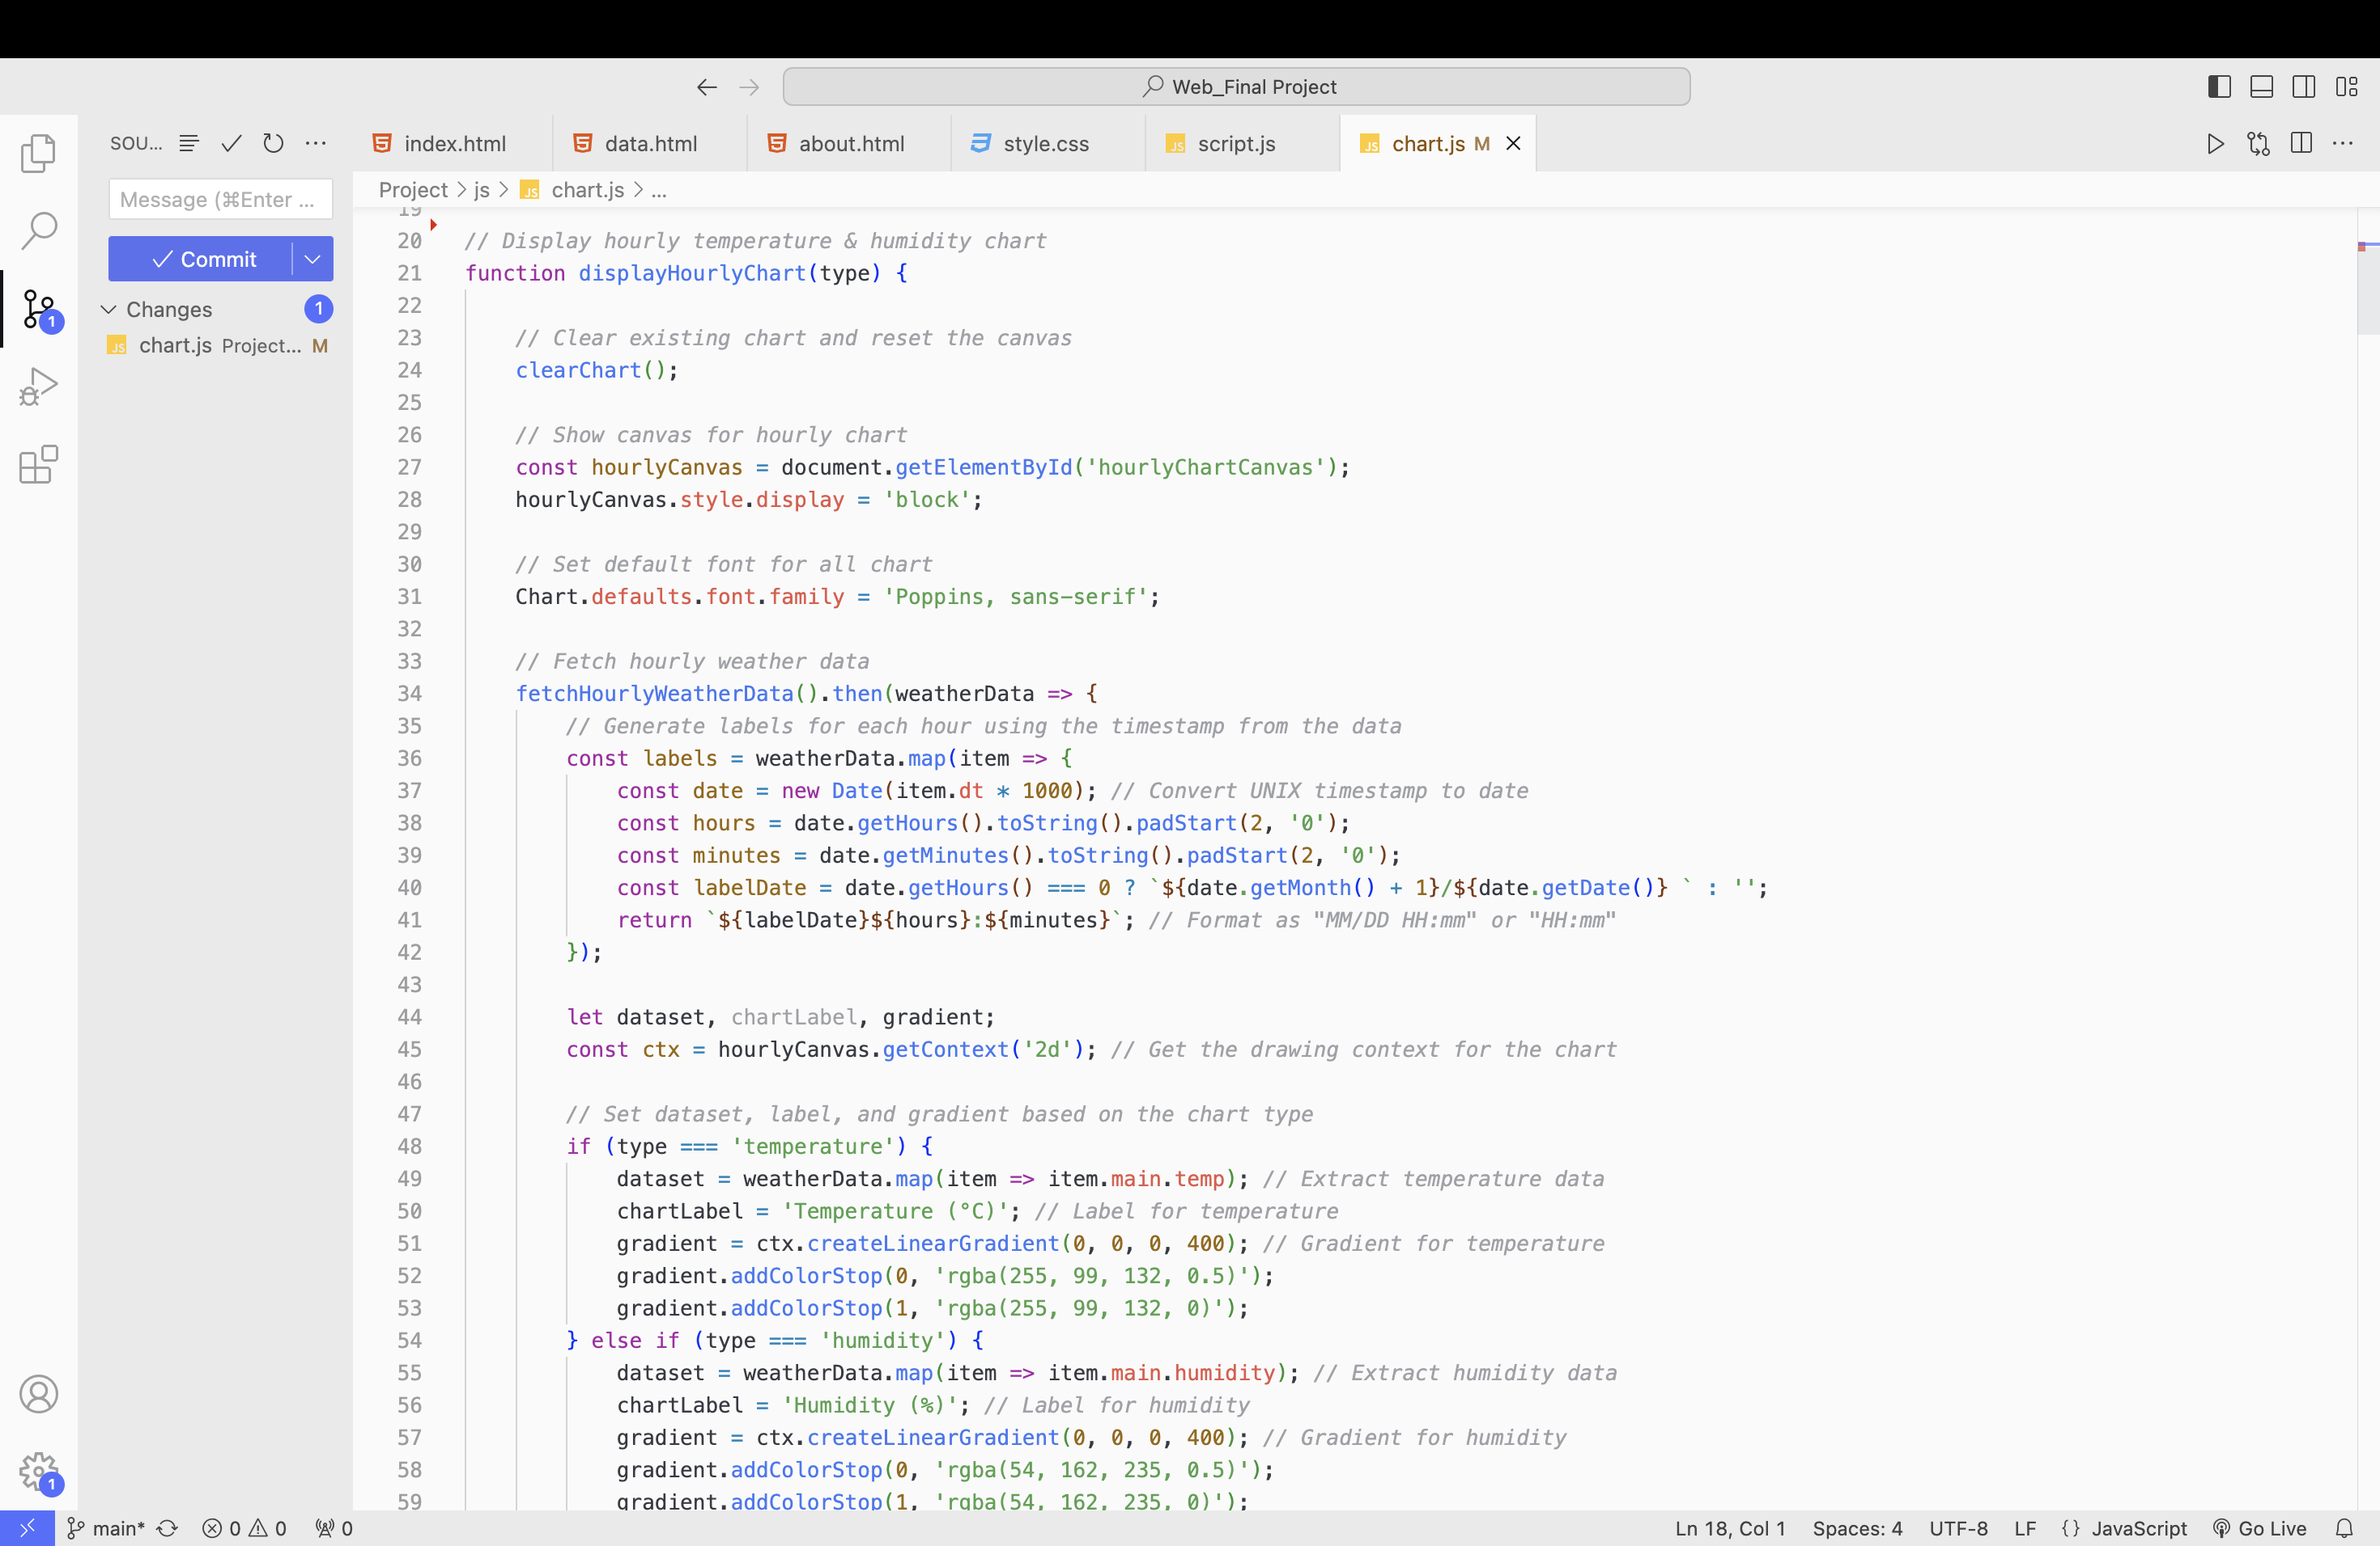
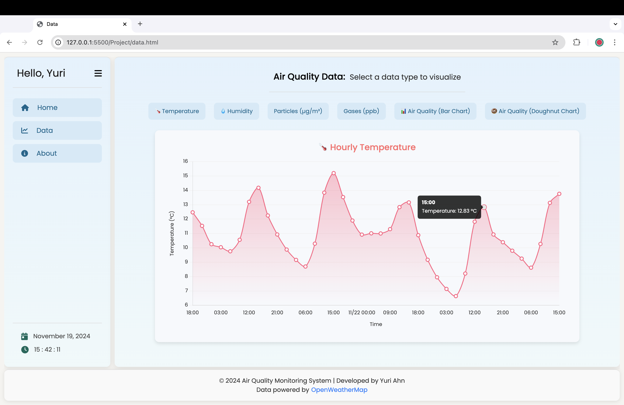
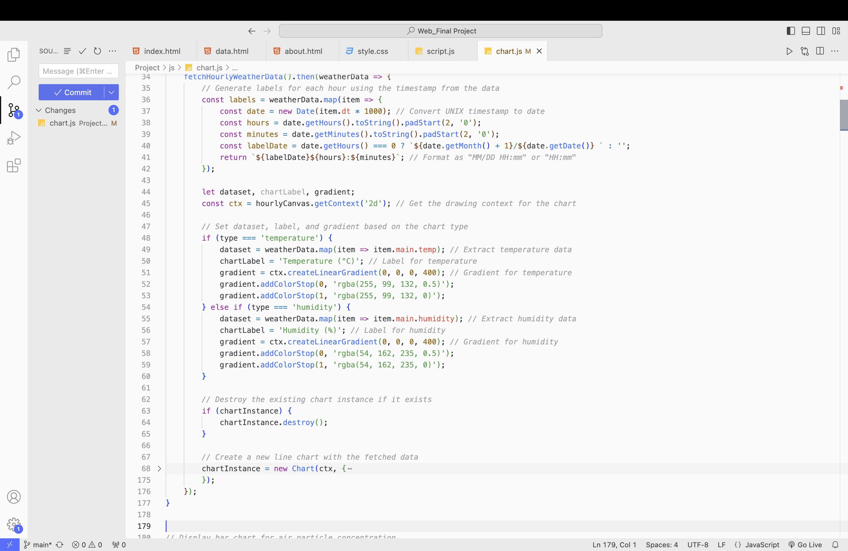
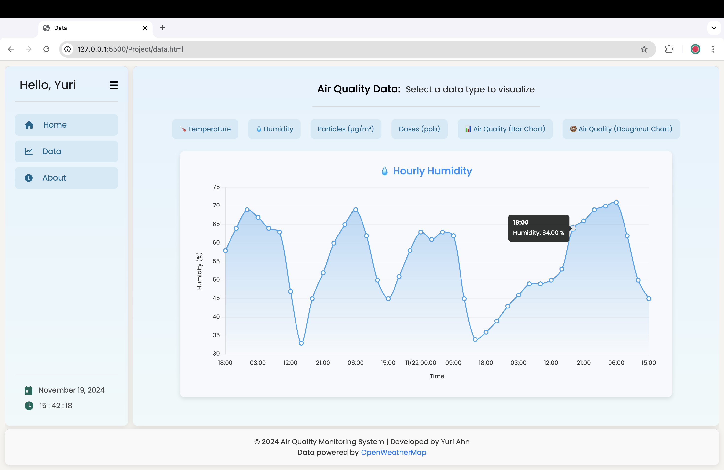
Visualizing Data

Slide 14
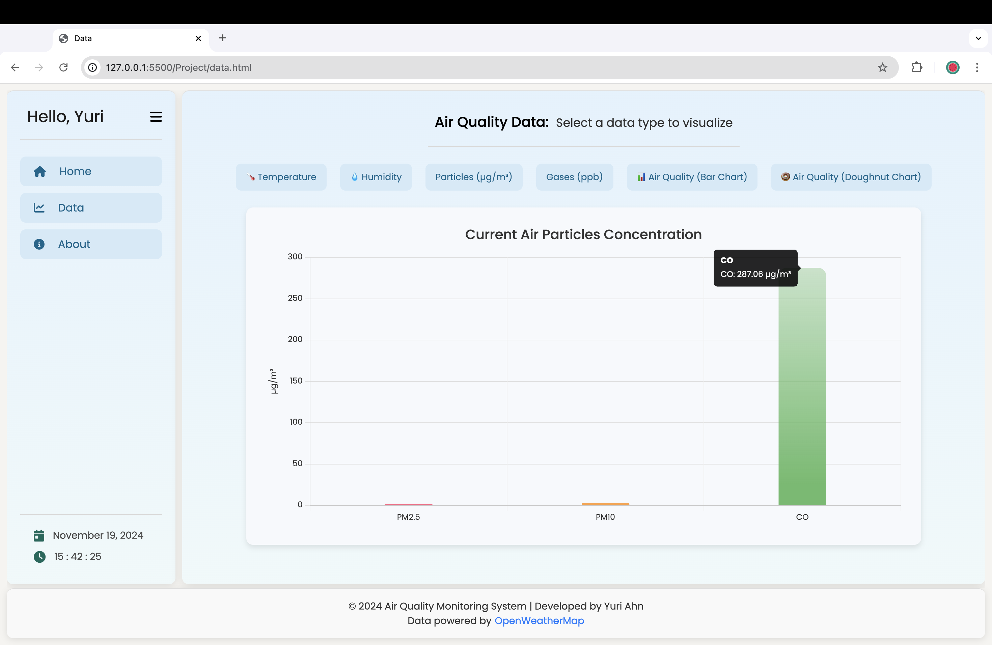
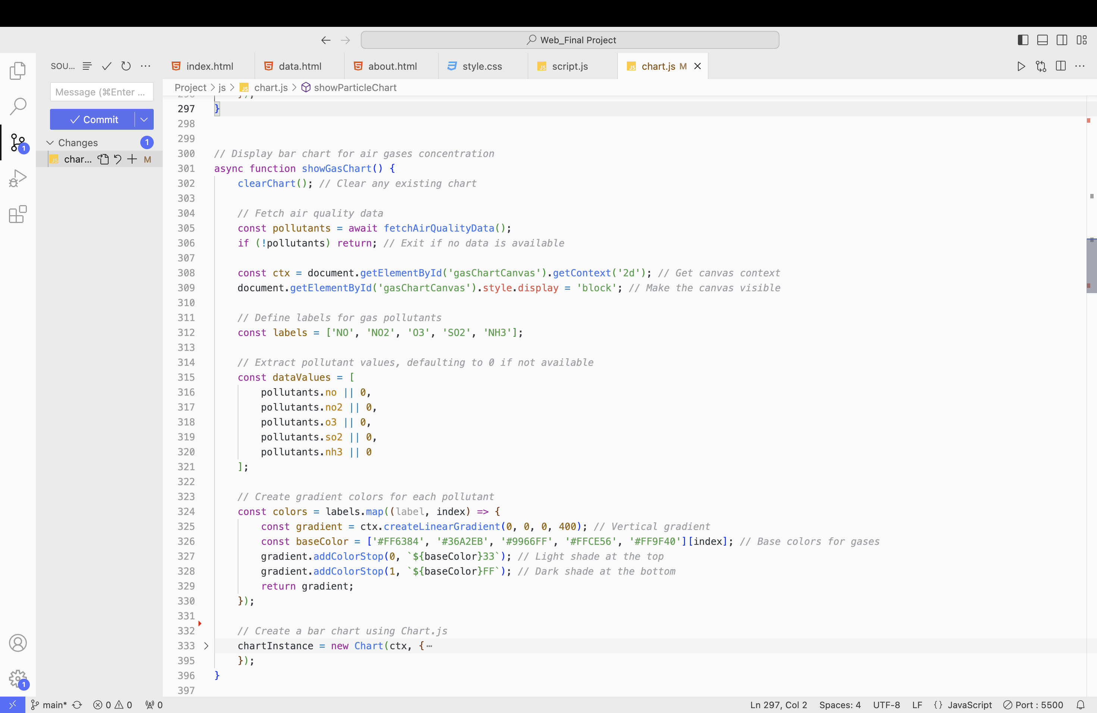
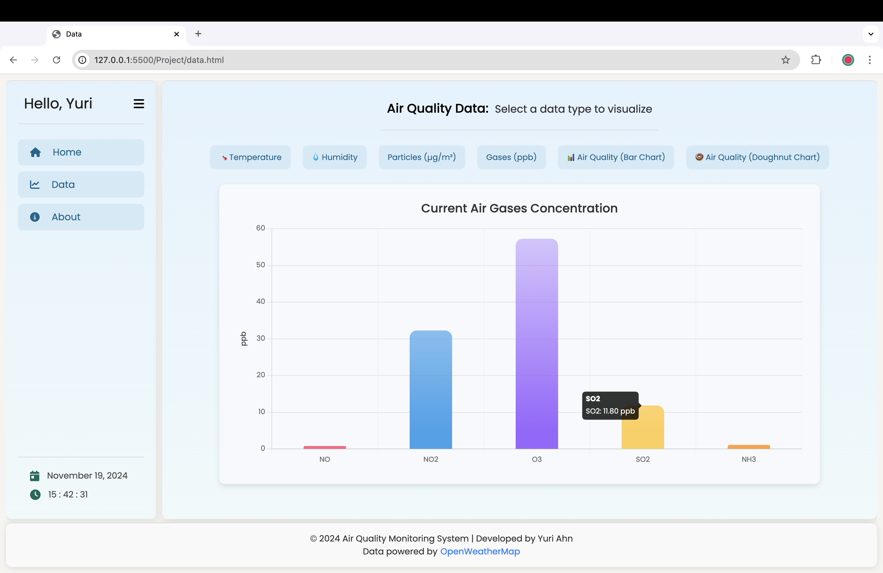
Visualizing Data

Slide 15
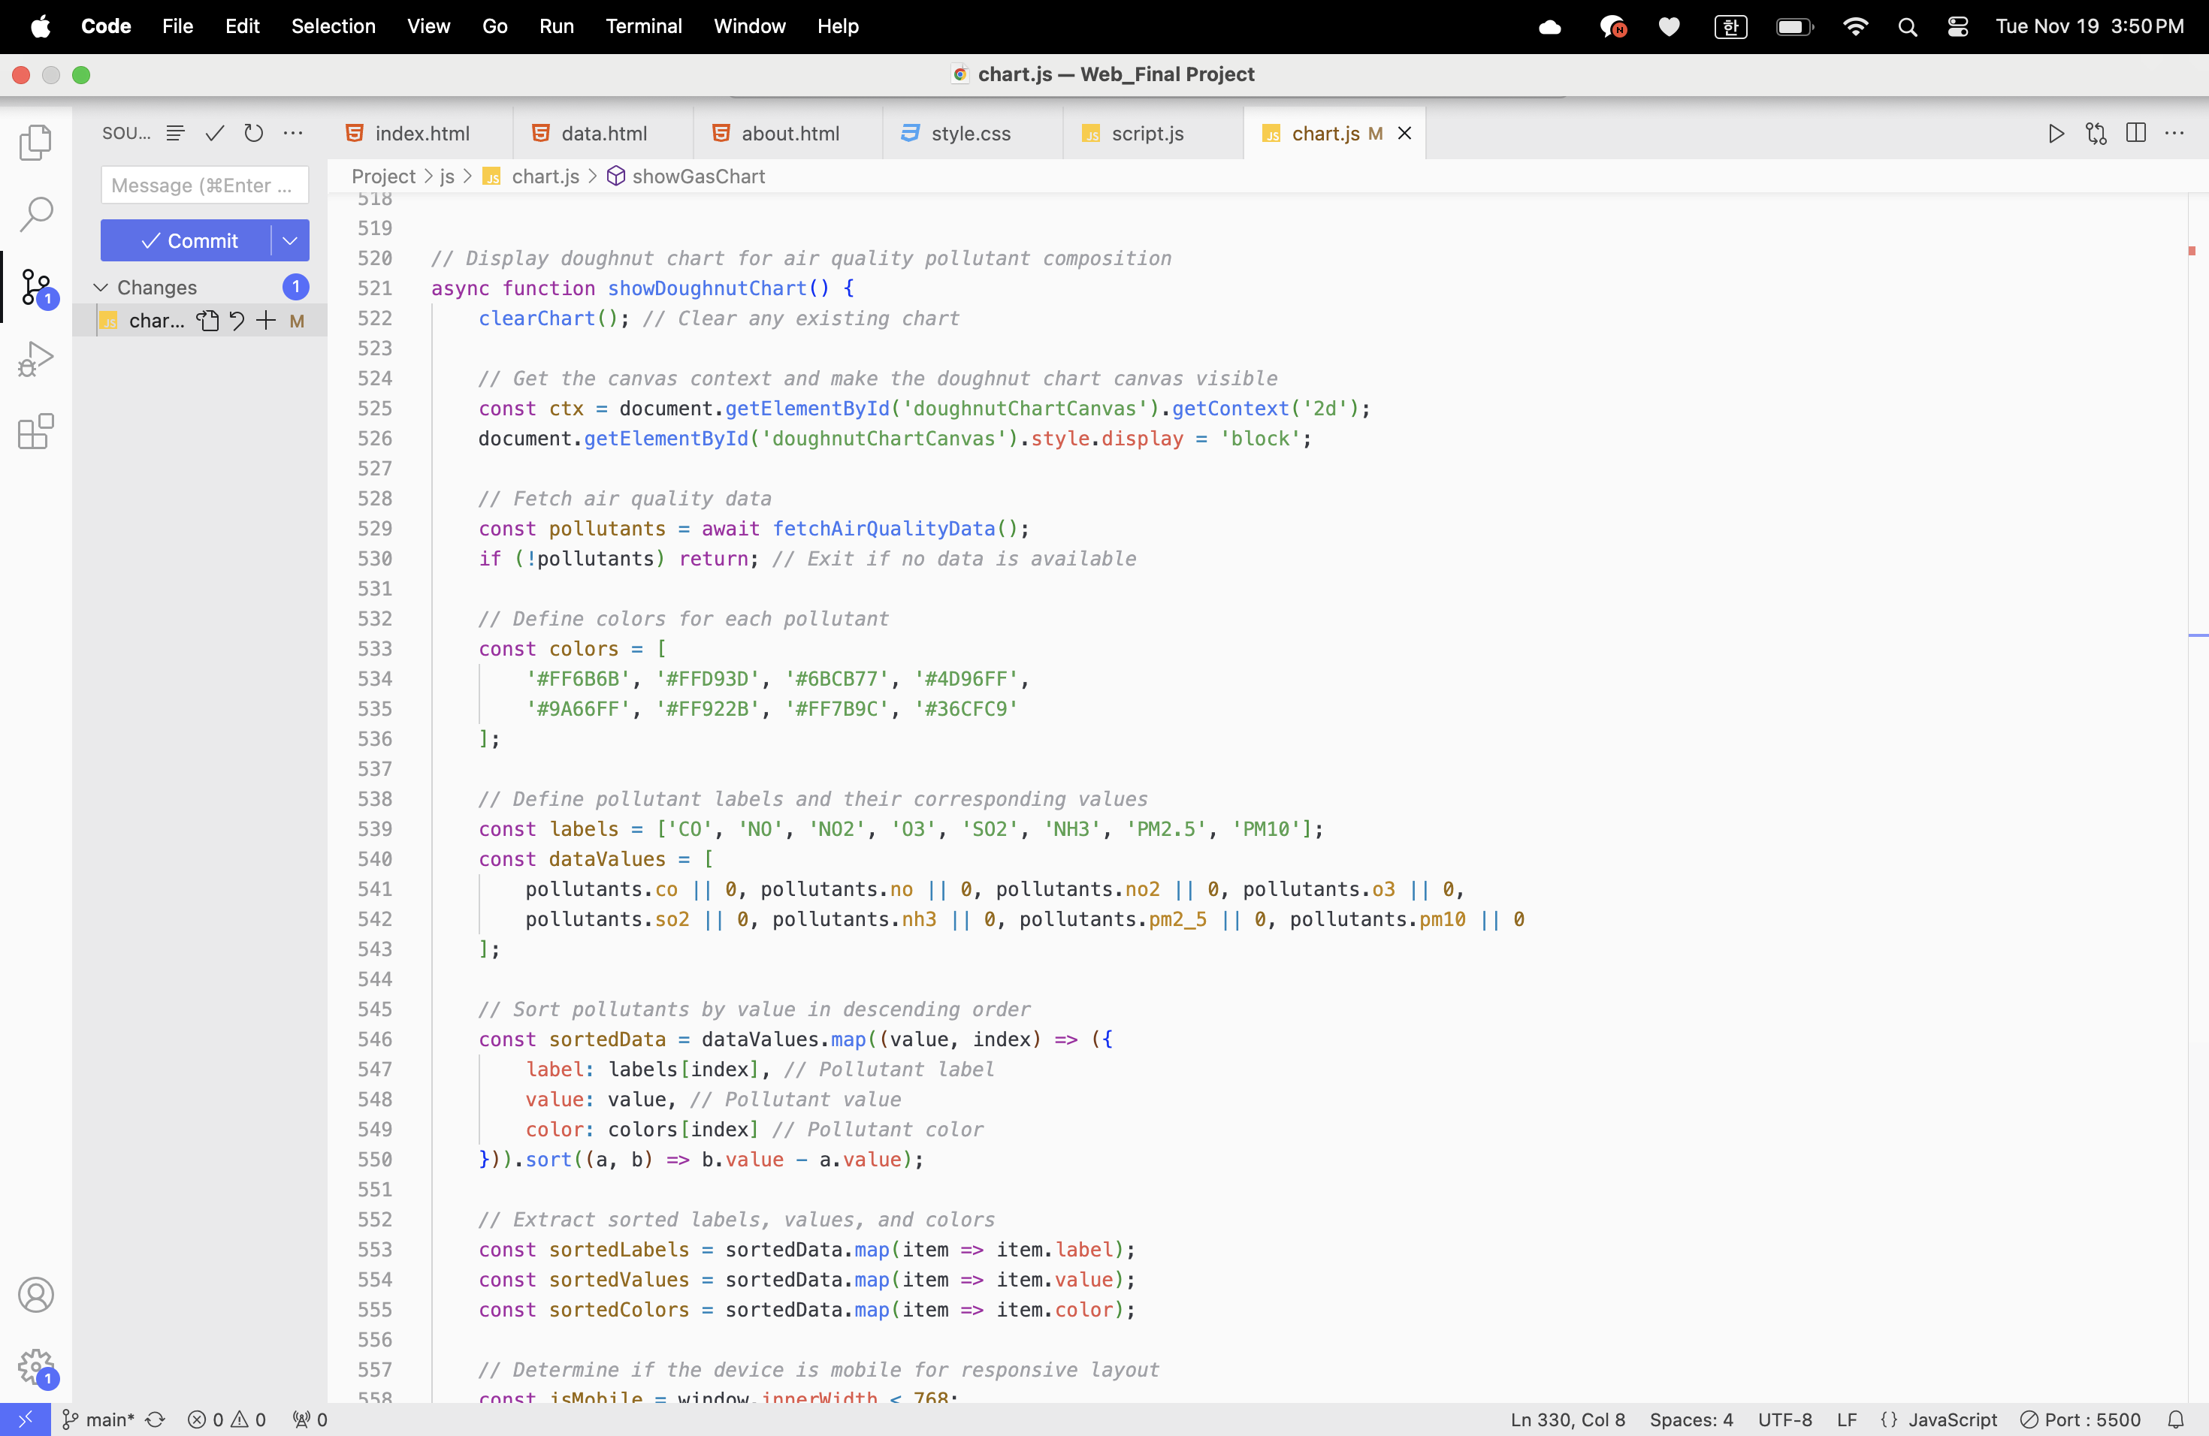
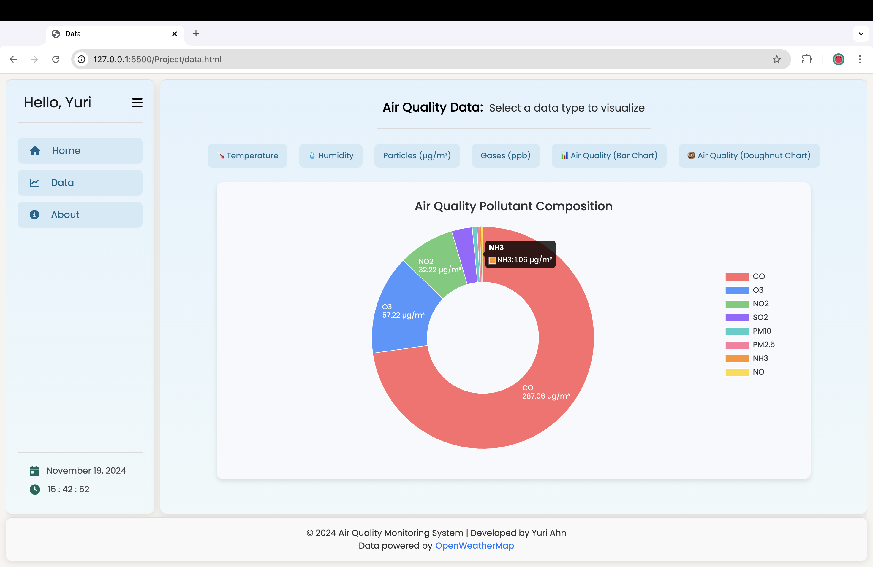
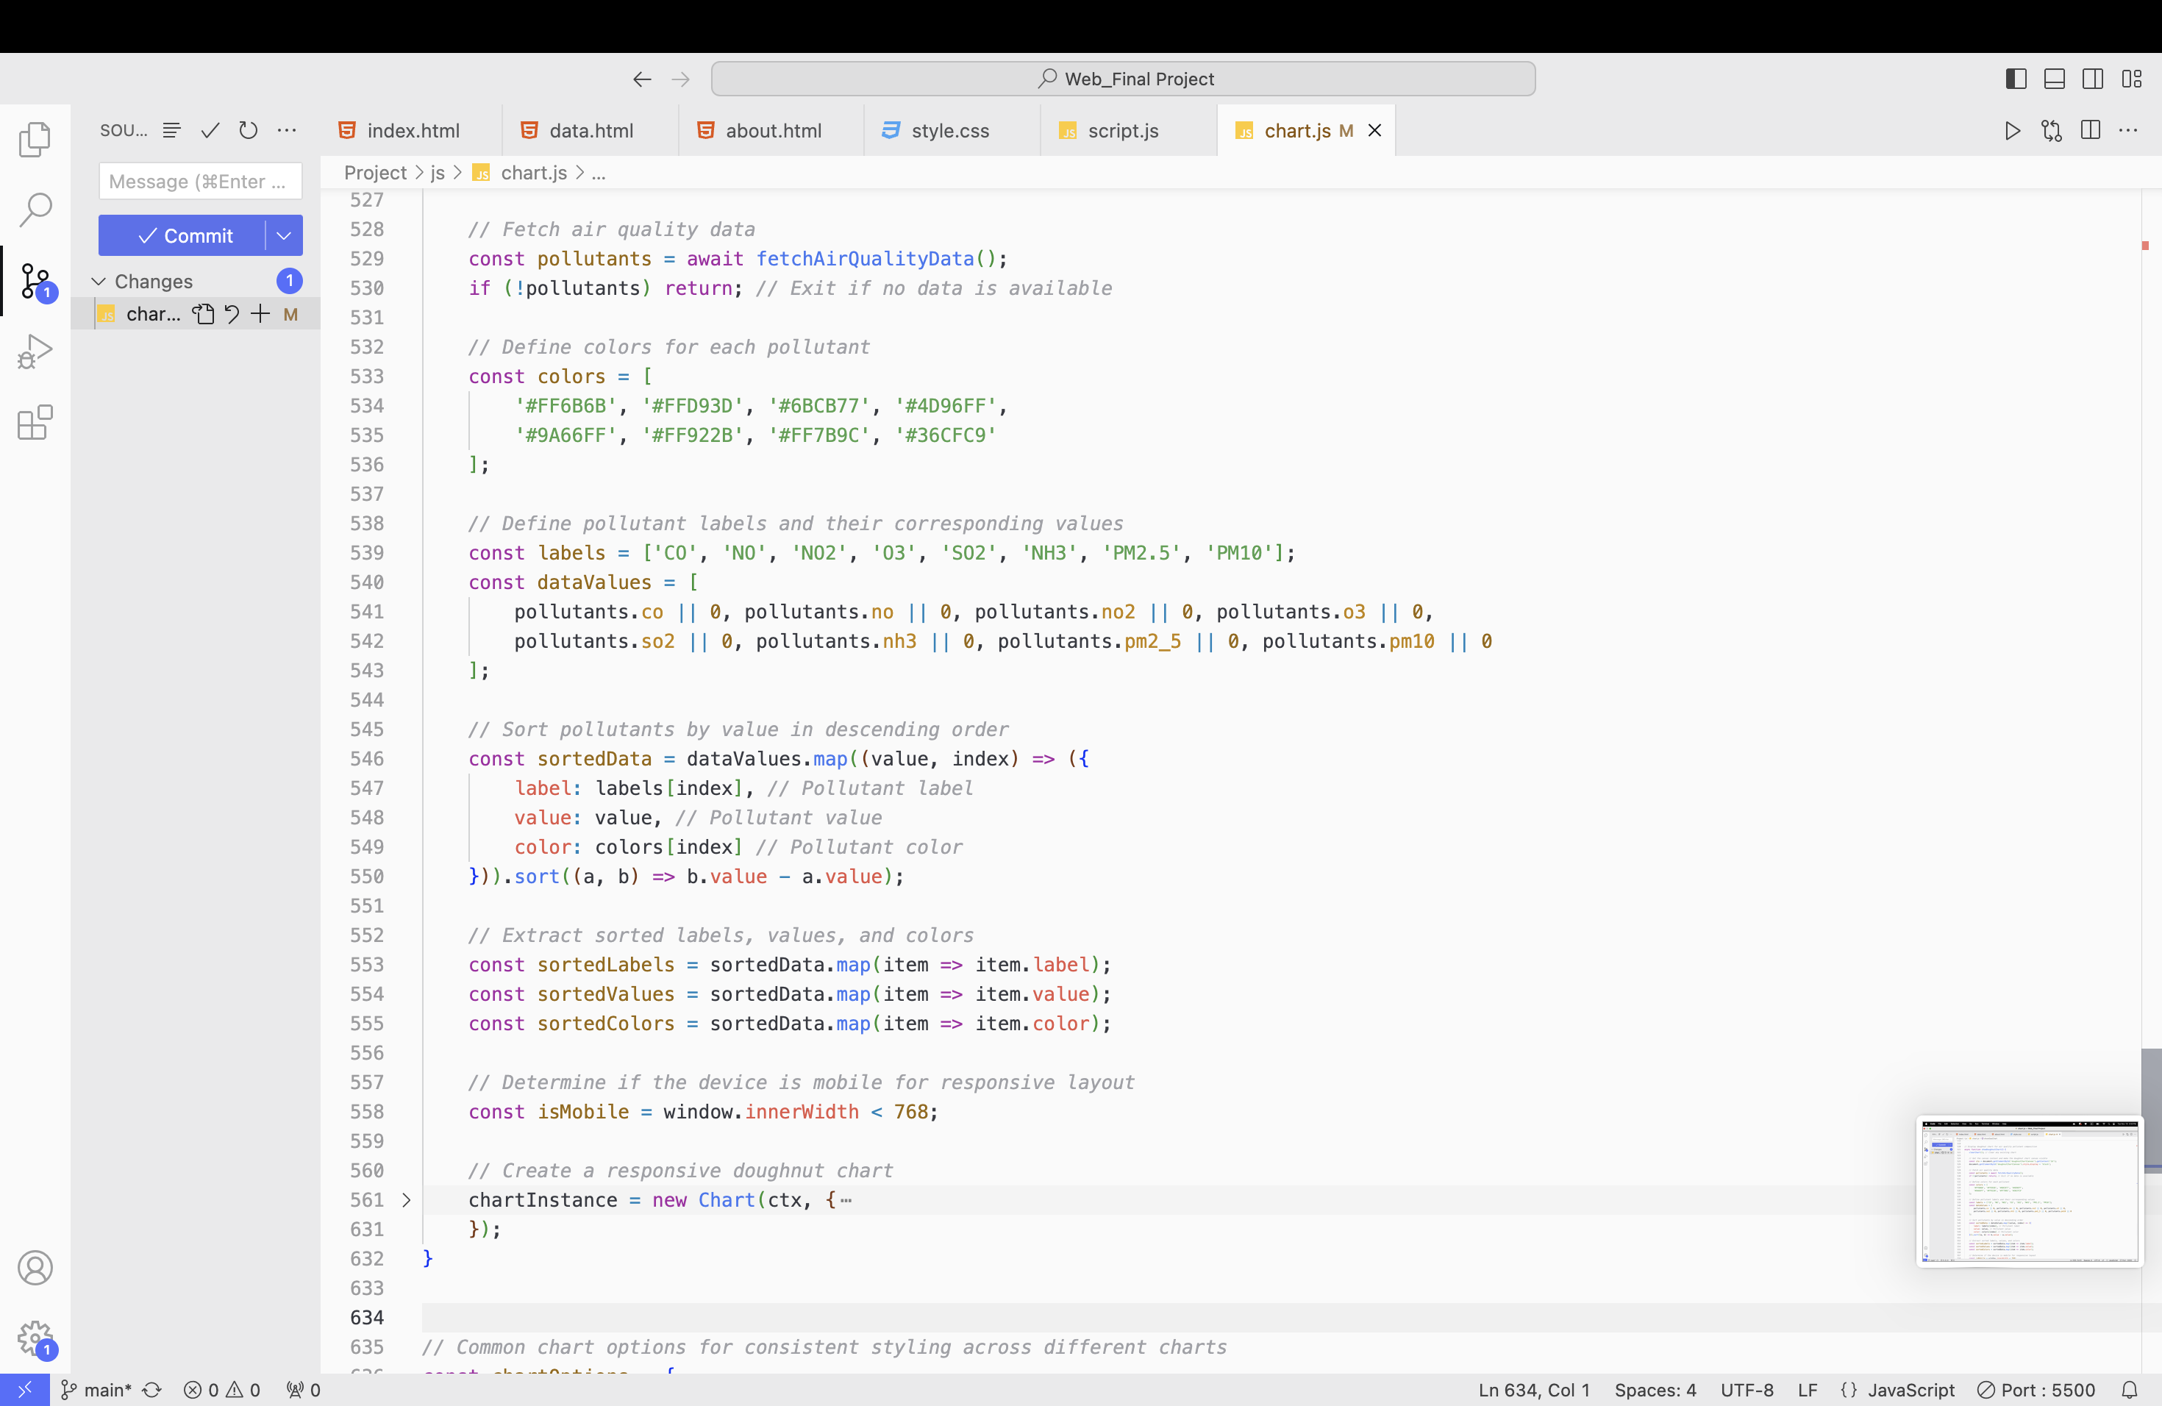
Visualizing Data

Slide 16
About the Dashboard: Insights and Development

Slide 17
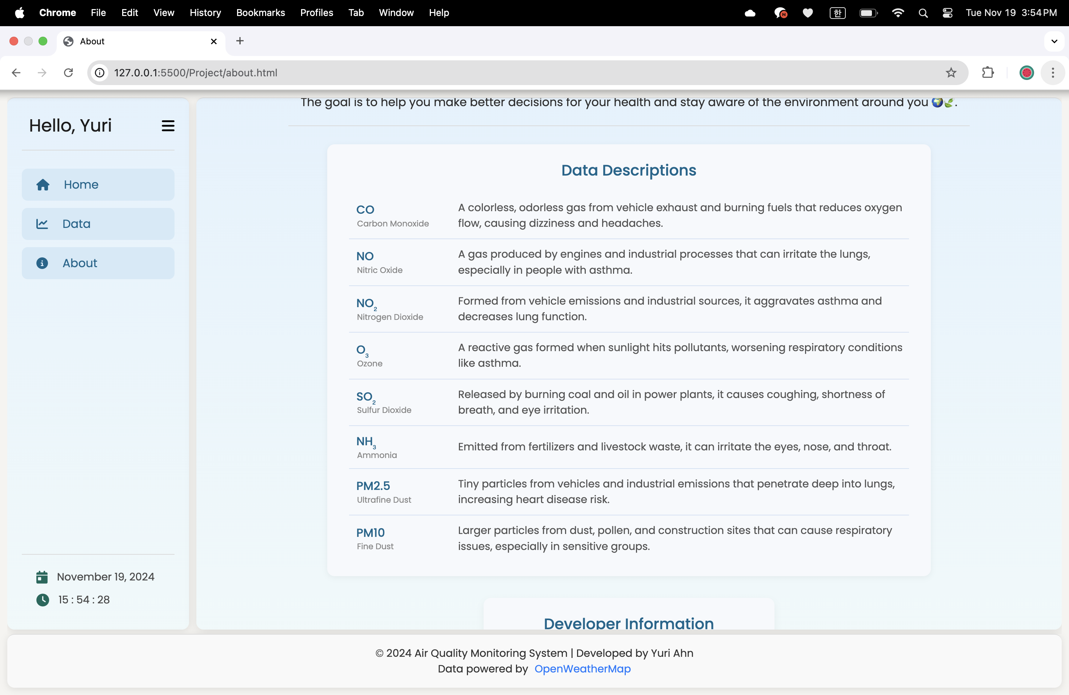
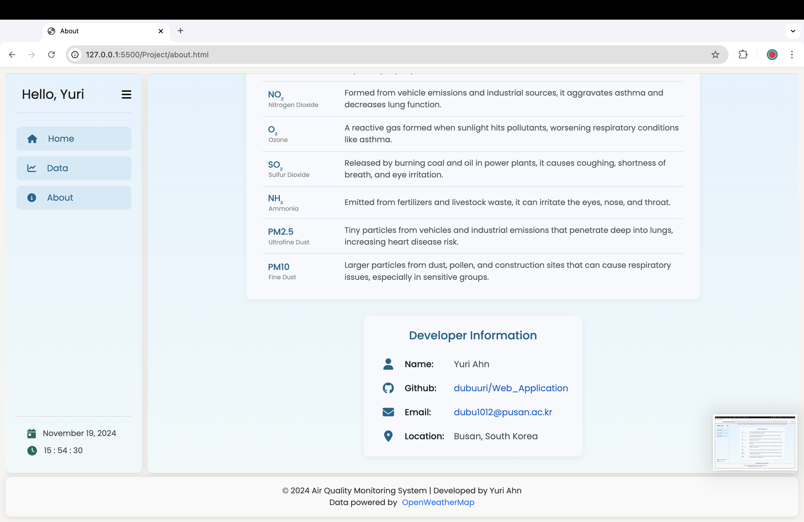
About the Dashboard: Insights and Development

Slide 18
Thank you for listening!

